Slide 1

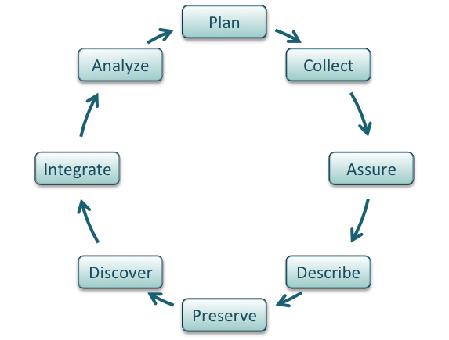
Data Integration Best Practices
Presented by: Tyson Swetnam & Justin Petucci

Slide 2
Strategic Implementation Plan Feedback Session Outline
SESSION TIME | ACTIVITY | DESCRIPTION | DURATION (MIN)
00:00 – 00:12 | Introduction | Session leads provide background and summary of NCEMS goals in topic area | 12
00:12 – 00:24 | Group Discussion | Groups of 6 form and consider 2-3 questions | 12
00:24 – 00:37 | Report Back | Groups of 6 report back to entire session; one group member uses Qualtrics form to record responses | 13

Slide 3

What is Data Integration?
Data Integration: The process of combining data from various sources, formats, and domains to provide a unified, cohesive view that enables deeper analysis and new insights.

Slide 4
NCEMS Data Integration
Vision: Empower NCEMS working groups by providing seamless access to harmonized, high-quality, and reproducible data in the MCB field, facilitating cutting-edge research, fostering interdisciplinary collaboration, and educating the next generation of scientists.
Definitions:
Working Groups (WGs) - The primary research drivers at NCEMS​. WGs are diverse teams of scientists that integrate ideas & theories across fields with publicly available data to get deeper, broader insights​
Staff scientists - NCEMS employees who support WGs with expert assistance in data wrangling, analyses, statistics, and data science methodologies​
Data Integration
Data-Quality
Assurance
FAIR Principles
Metadata Standards
Reproducibility & Transparency
Adherence to established standards
Open Science

Slide 5
Interfaces Between NCEMS Staff and Working Groups
Staff Scientists
Collaborate with the WGs to create Data Management Plans (DMPs)
Carry out required data integration efforts
Coordinate the computational needs on CyVerse as well as ACCESS-CI for HPC, HTC, and Cloud resources
Provide WGs with detailed documentation, training, and support in use of integrated data products
Maintain data quality standards and ensuring intermediate data products are FAIR
Conduct regular reviews of processes in conjunction with WGs to ensure they are fit to purpose
Working Groups (WGs)
Define datasets and underlying synthesis questions and inform staff scientist(s) of applicable existing standards

Slide 6

Data Integration – Discussion Questions
How should NCEMS staff scientists interface with working groups before, during, and after data integration processes? (Identify key information and resources that should be exchanged to ensure success)
What general quality assurance steps and checks should be standardized across all NCEMS data products?
(Optional) What technical challenges do you foresee that could hinder the effective integration of data in the molecular and cellular sciences?

