Slide 1


National Remote Research Experience
Presented by: Melanie McReynolds & Ed O’Brien
Notes:
We need a captivating graphic here…

Slide 2
SIP Feedback Session Schedule
SESSION TIME | ACTIVITY | DESCRIPTION | DURATION (MIN)
00:00 – 00:12 | Introduction | Session leads provide background and summary of NCEMS goals in topic area | 12
00:12 – 00:24 | Group Discussion | Groups of 6 form and consider 2-3 questions | 12
00:24 – 00:37 | Report Back | Groups of 6 report back to entire session; one group member uses Qualtrics form to record responses | 13

Slide 3
What is the National Remote Research Experience?
The NRRE facilitates undergraduates from any institution across the country to remotely take part in synthesis research projects during the school year (September through March)
  Projects are proposed by NCEMS working groups, postdocs, and outside faculty across the country
  Projects are posted online; undergraduates and mentors apply to work on the project (the proposer and mentor do not need to be the same person)
  Mentors and undergraduates are matched by NCEMS based on mutual interest
  Clear expectations concerning time commitments and regular meetings for both mentor and undergraduate are agreed upon
  NCEMS supports research via cyberinfrastructure (CyVerse), training (software, coding, statistics, data wrangling), and technical support through virtual office hours
  NCEMS builds community through starting and ending virtual presentations
  NCEMS will recognize research efforts by collecting final project reports, encouraging publication, and recognizing the most significant discoveries at the annual NCEMS meeting

Slide 4
NRRE Timeline
Feb 1 – March 15
Proposals accepted from Working Groups, Postdocs, and outside faculty
March 15 – May 1
Open application period for undergraduates
May 1 – July 15
Applications reviewed; students are matched with projects
July 15 – August 1
Notifications of acceptance are sent to undergraduates and mentors
August 15
Final acceptance of participation

Slide 5


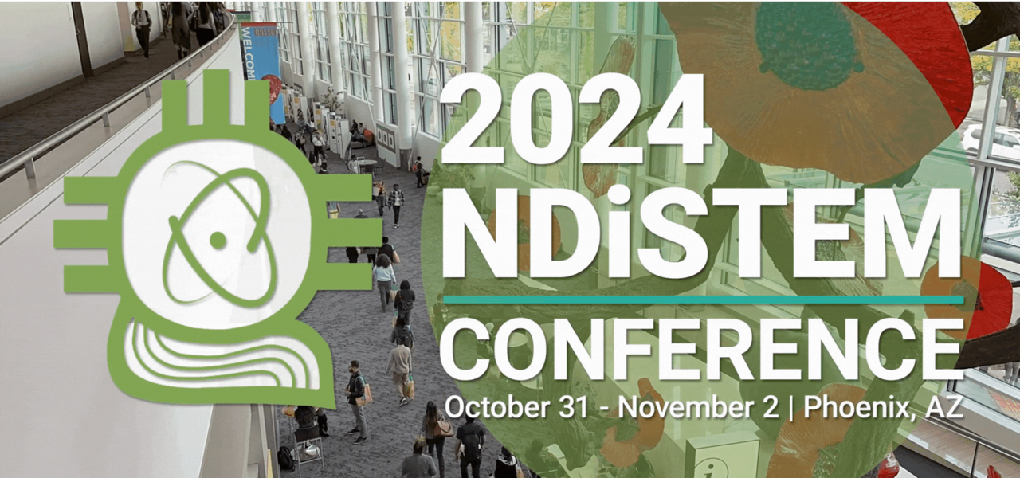

Plans for NRRE recruitment
NCEMS website and listserve
Email outreach to colleges and universities across the country
NCEMS social media
  X (Twitter)
National meetings
  NOBCChE
  NDiSTEM (SACNAS)
  ABRCMS
  Biophysical Society
  American Society for Biochemistry and Molecular Biology

Slide 6
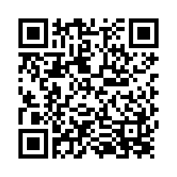
NRRE – Discussion Questions
NRRE
(1) How can we promote effective coordination and building strong connections between remote undergrads, mentors, and NCEMS computational resources?
(2) How can we effectively recruit undergrads and mentors to the NRRE?
(3) (Optional, only if time allows) How should we recognize the efforts of the undergrads and mentors?

