Slide 1

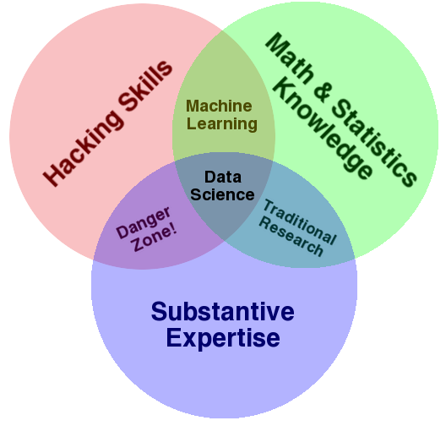
Team Science Best Practices
Presented by: Brian Uzzi, Brian Manata, & Ed O’Brien
(Working Groups)

Slide 2
Strategic Implementation Plan Feedback Session Outline
SESSION TIME | ACTIVITY | DESCRIPTION | DURATION (MIN)
00:00 – 00:12 | Introduction | Session leads provide background and summary of NCEMS goals in topic area | 12
00:12 – 00:24 | Group Discussion | Groups of 6 form and consider 2-3 questions | 12
00:24 – 00:37 | Report Back | Groups of 6 report back to entire session; one group member uses Qualtrics form to record responses | 13

Slide 3
Team Science at NCEMS
Working Groups (WGs) are the primary research drivers at NCEMS.
NCEMS aims to support ~36 WGs in its first five years.
WGs are diverse teams of scientists that integrate ideas & theories across fields with publicly available data to get deeper and broader insights
Staff scientists are NCEMS employees who support WGs with expert assistance in data wrangling, analyses, statistics, and advanced data science methodologies
Staff scientist assistants are senior graduate students matrixed out to WGs
WGs meet in-person for a 3-day kickoff; the rest of their collaborative research happens virtually

Slide 4
NCEMS support for WGs
WGs apply for up to two years of support
NCEMS support for WGs
NCEMS staff scientist & staff scientist assistant time
Cyberinfrastructure & open science support & training
Funding for travel, publication costs, and short-term visitors
Project management
In collaboration with WGs, NCEMS staff
Data quality assessments, literature reviews, preliminary analyses
Wrangle and harmonize diverse data
Facilitate regular meetings
Train and guide WG members
(Working Groups)
Working Groups
NCEMS Staff Scientists
NCEMS Staff Scientist Assistants

Slide 5

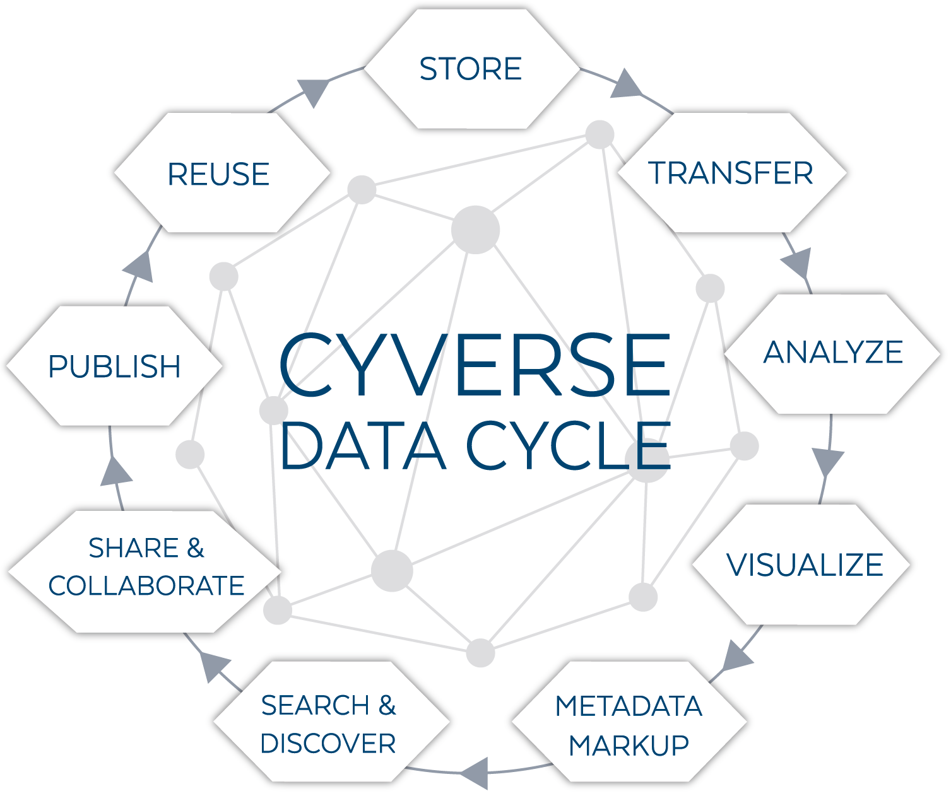
Enabling Team Science at NCEMS
Largest ever investment by the NSF in cyberinfrastructure for the Life Sciences
Provides cloud computing, software, and training in Open & Team Science practices
Enables seamless collaboration on data harmonization tasks and subsequent analyses

Slide 6
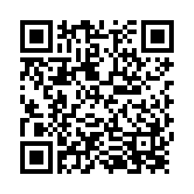
Team Science – Discussion Questions
What is the leader’s role in a virtual team? What challenges do you envision here?
How do you build a culture of innovation in a virtual team? What challenges do you envision here?
(Optional, only if time allows) How do you promote trust in a virtual team? What challenges do you envision here?

