Slide 1


Complete the pre-training survey
WiFi: ASBMB
Password: UTSWDallas
The pre-training survey is mandatory - you must complete it to be sent a link to an AWS Cloud instance and access the training materials
Notes:
Dan

Slide 2
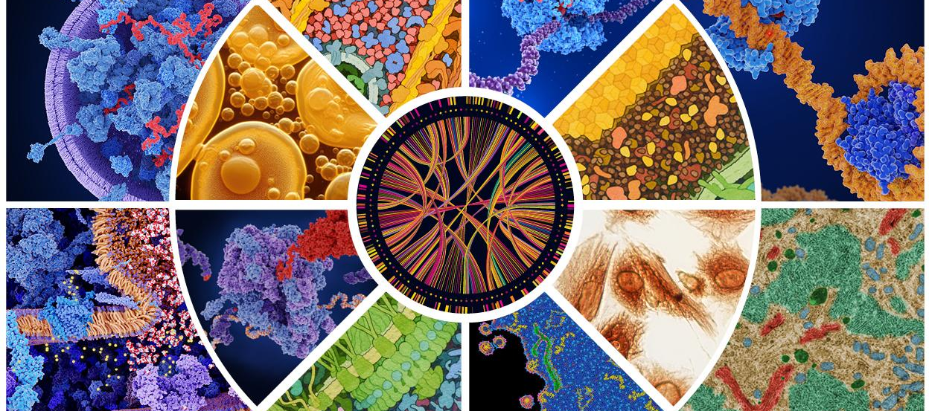
National Synthesis Center for Emergence in Molecular and Cellular Sciences (NCEMS)
MISSION​
NCEMS drives understanding of how life processes emerge from biological interactions by transcending disciplinary boundaries to catalyze community-scale synthesis research
Community-scale research is research beyond the capabilities of most individual labs, and requires a team science approach
Synthesis research involves the reuse and integration of diverse, publicly available data, theories, computational methods to obtain deeper and broader insights

Slide 3

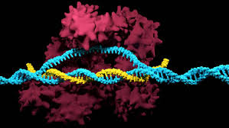
Transformative discoveries come from identifying and dissecting emergent phenomena
Emergent property: a property that is not present in the individual components but arises from interactions between the components
Circadian Rhythm
Jeffrey C. Hall, Michael Rosbash & Michael W. Young
RNA interference
Andrew Fire & Craig Mello
~2006-2011
2006 (Nobel prize)
2017 (Nobel prize)
CRISPR-Cas9 Genome Editing
Jennifer Doudna & Emmanuelle Charpentier

Slide 4
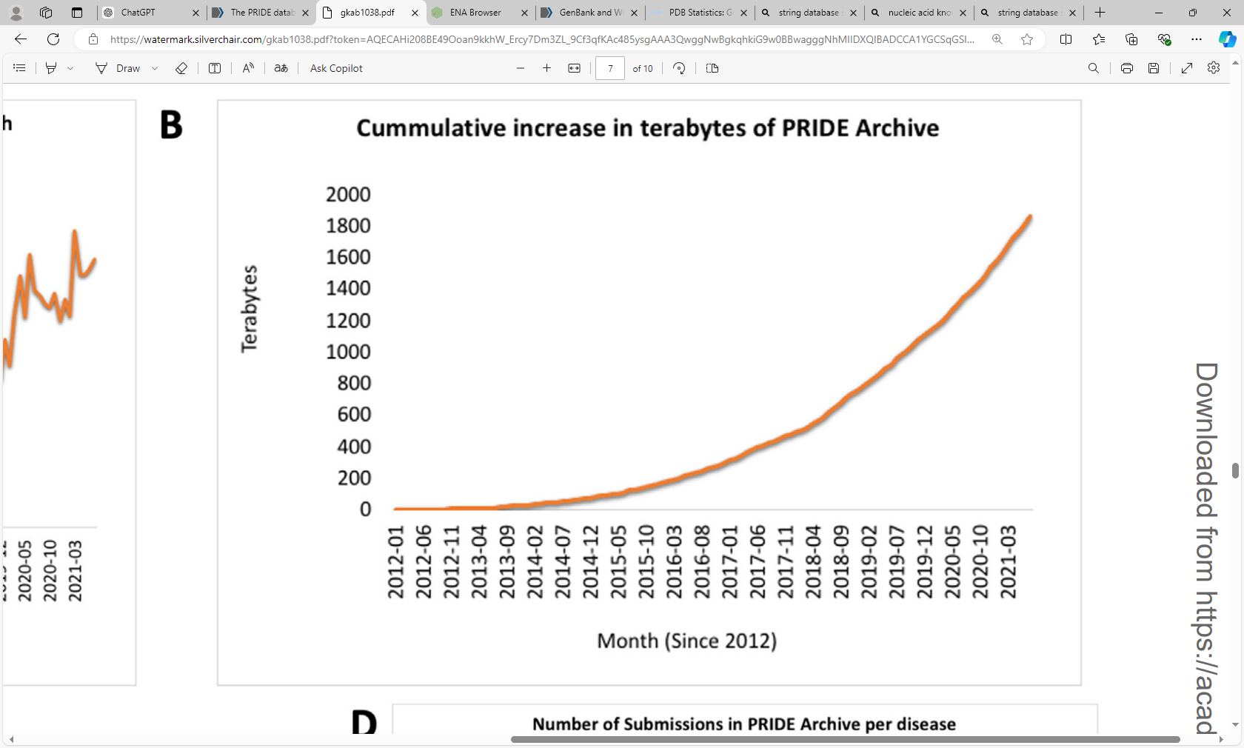
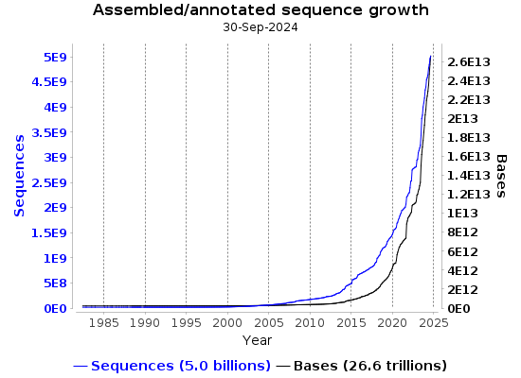
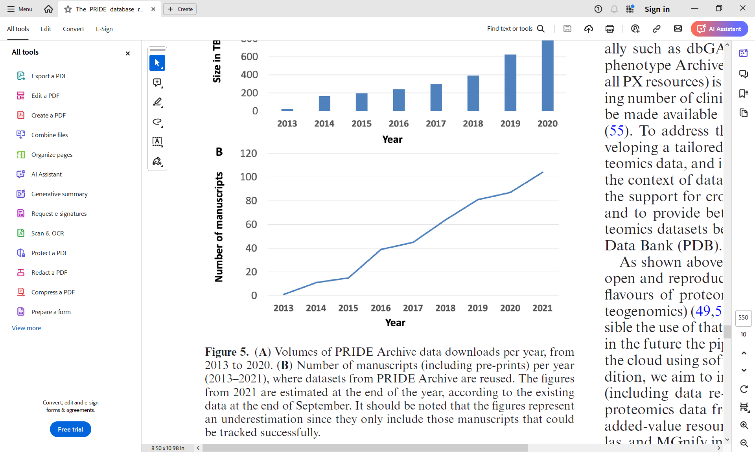
Unprecedented growth of Molecular and Cellular Biology data
More data generation methods
More data (exponential growth)
Next-generation sequencing
ChIP-seq
NET-Seq
RNA-seq
RCP-Seq
TI-Seq
Ribo-seq
Disome-Seq
Sel-Ribo-seq
.
.
.
249. PARE-Seq
Mass spectrometry
HDX-MS
XL-MS
LiP-MS
ESI-MS
CLIR-MS
LILBID-MS
qXL-MS
AAL-MS
.
.
.
15. SILAC-MS
Imaging
Cryo-EM
Cryo-ET
Live-cell imaging
smTag
MS2-FP
PP7-FP
TRICK
TREAT
.
.
.
10. Light-up Aptamers
Mass spec
NGS
PRIDE
European Nucleotide archive
Sparse data reuse (linear growth)
Perez-Riverol et al. Nucleic Acids Research (2022)
Perez-Riverol et al. Nucleic Acids Research (2022).

Slide 5
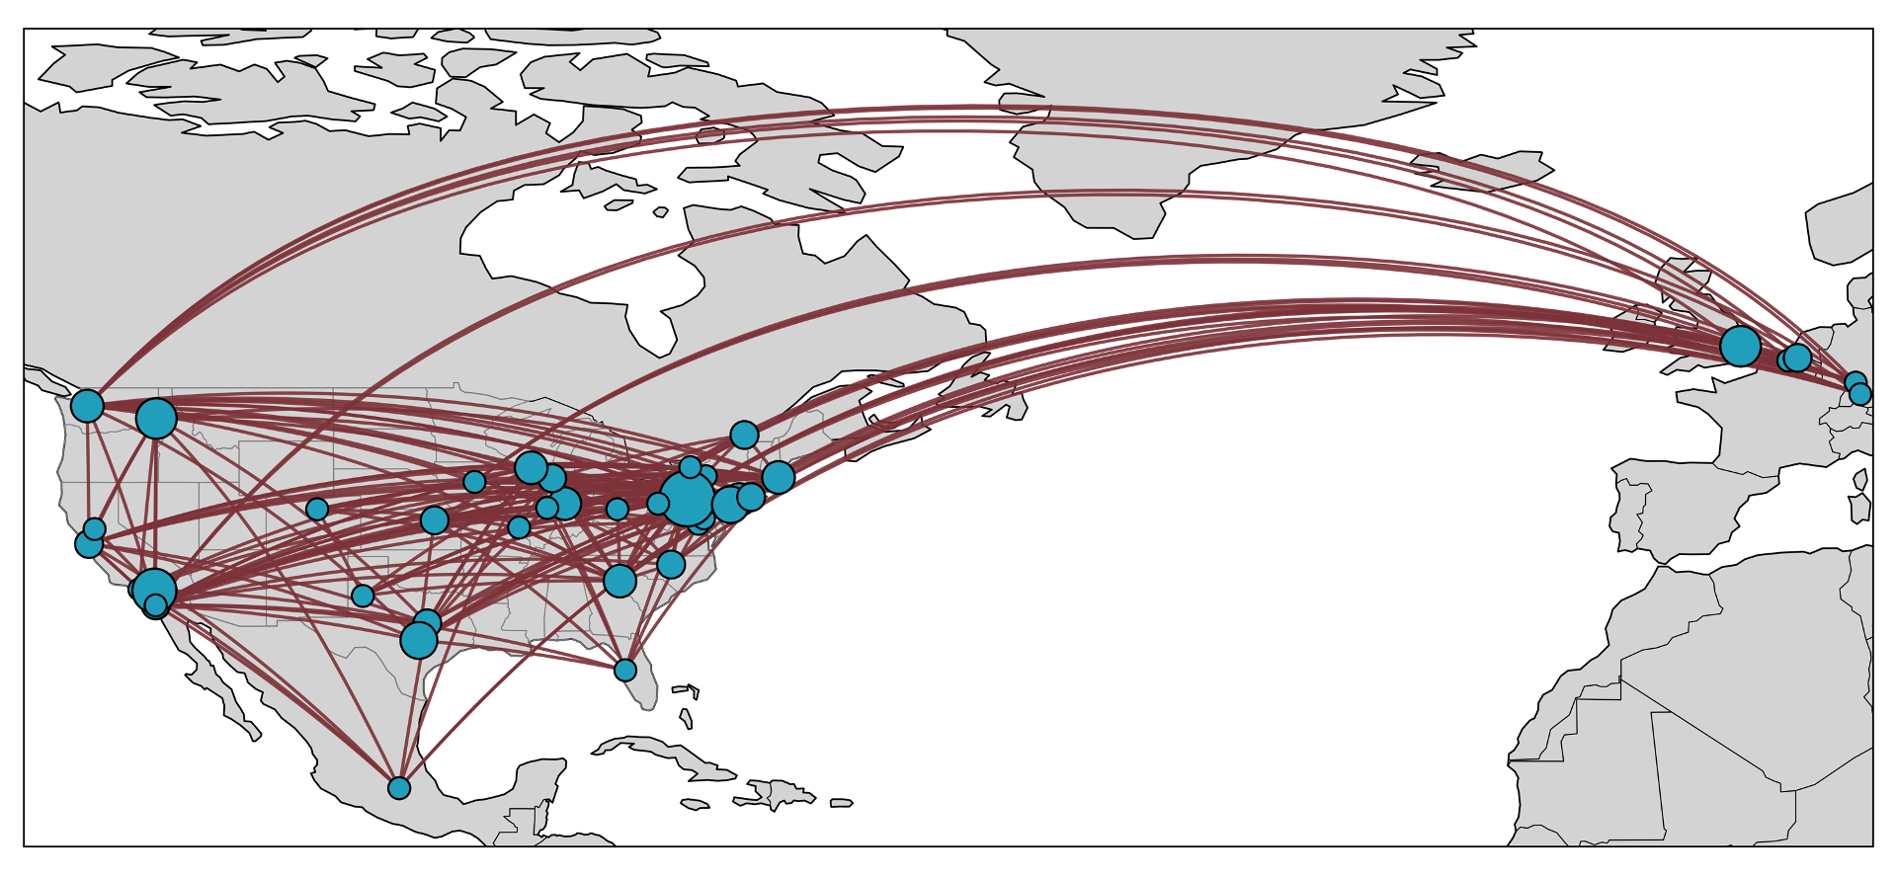
NCEMS Working Groups
•10 Working Groups
•32 leads & co-leads
•87 total participants
•43 institutions
•18 states + Washington, DC
•6 countries
Perez-Riverol et al. Nucleic Acids Research (2022).

Slide 6

Hands-on Training
Four Interpretable Machine Learning Techniques to Immediately Accelerate your Research
Presented by
The NSF National Synthesis Center for Emergence in the Molecular and Cellular Sciences (NCEMS)

Slide 7



Meet your instructors
Justin Petucci
NCEMS Assoc. Director
Penn State Institute for Computational and Data Sciences
Maowei Dong
NCEMS Project Manager
Penn State Huck Institutes of the Life Sciences
Dan Nissley
NCEMS Chief Scientific Officer
Penn State Institute for Computational and Data Sciences

Slide 8
Key questions you will learn how to address during this training:
You have a hypothesis - how can you test it?
Someone claims an alternative hypothesis can explain your data - how can you control for it?
You have tons of data on the properties of your system - how can you decide which properties are relevant?
How do you avoid wasting time on false positives?
Section 1 - Quantifying the association of a feature with an outcome
Section 2 - Controlling for confounding factors
Section 3 - Identifying features that may drive outcomes
Section 4 - Avoiding data overinterpretation

Slide 9
Training structure
In each section you will:
First, watch an instructor present the general concept and describe a complete example
Second, open a Jupyter Notebook and carry out a complete example following along with an instructor
  At the end of this example, you will be asked to test your knowledge with a quick (anonymous) quiz question

Slide 10

This training will not cover…
programming in Python in detail
details of the theory justifying the analyses we perform
  additional information is included in the Theory & Background packet

Slide 11
A few last things
You do not need to take notes - all materials will be made available to you on request following the training
Do not try to “work ahead” - stay in sync with the instructor so you do not miss crucial information or instructions
If you have any technical issues raise your hand and an instructor will walk over to help you

Slide 12
A few last things
Put your laptop on battery-saver mode
  You will not be running any computation locally; only an internet browser is needed
Close your laptop when you are watching the instructor

Slide 13
Complete the pre-training survey
WiFi: ASBMB
Password: UTSWDallas
The pre-training survey is mandatory - you must complete it to be sent a link to an AWS Cloud instance and access the training materials
Notes:
Dan

Slide 14
Section 1 - Quantifying the association of a feature with an outcome
Motivating question: You have a hypothesis - how can you test it?
We can compute the association - what does association mean?
  If two variables are associated, information about one provides information on the other
  A feature (parameter) and outcome (what we want to predict) might be associated
  We need to determine if they have a relationship and if it is real or random
How can we quantify association?
  Write down a contingency table, calculate the odds ratio, and check for statistical significance
Why is this important?
  Make data-driven decisions
  Avoid false conclusions

Slide 15
Section 1 - Quantifying the association of a feature with an outcome
Motivating question: You have a hypothesis - how can you test it?
General process:
organize your data into a contingency table,
calculate an odds ratio to determine if a feature is associated with an outcome,
use Fisher’s Exact Test to determine if the result is statistically significant
Take-home message: This procedure allows you to distinguish real relationships between features and outcomes from random relationships.

Slide 16
Section 2 - Controlling for confounding factors
Motivating question: Someone claims an alternative hypothesis can explain your data - how can you control for it?
We can check for the presence of confounding factors
  A confounding factor is a variable associated with both a feature and an outcome
  Confounding factors distort the true relationship between the feature and outcome
How can we control for confounding factors?
  Build a logistic regression model with and without the potential confounding factor
Why is this important?
  Confounding factors can prevent us from drawing correct conclusions

Slide 17
Section 2 - Controlling for confounding factors
Motivating question: Someone claims an alternative hypothesis can explain your data - how can you control for it?
General process:
Build logistic regression model of outcome including only your feature
Build logistic regression of outcome including feature and potential confounder
Compare odds ratios for feature in absence and presence of confounder
Take-home message: We can use this procedure to test if a possible confounding factor influences our interpretation of the relationship between a feature and an outcome

Slide 18
Section 3 - Identifying features that may drive outcomes
Motivating question: You have tons of data on the properties of your system - how can you decide which properties are relevant?
We can easily generate thousands of features that might influence a given outcome
Some machine learning methods provide feature selection
  The features that most strongly influence an outcome are preserved, others are passed to zero
  Least Absolute Shrinkage and Selection Operator (LASSO) is one example
How can we carry out this procedure and interpret the results?

Slide 19
Section 3 - Identifying features that may drive outcomes
Motivating question: You have tons of data on the properties of your system - how can you decide which properties are relevant?
General process:
Build a regression model to predict your outcome from the features with LASSO to perform feature selection
Choose a value of λ that results in a reasonable number of features (you decide what this means!)
The features with the largest coefficient magnitudes have the strongest influence on the results
Take-home message: You can use machine learning methods like LASSO to identify the features that are most important for predicting your outcome

Slide 20
Section 4 - Avoiding data overinterpretation
Motivating question: How do you avoid wasting time on false positives?
Modern scientific techniques like next-generation sequencing produce massive amounts of data
  When you test multiple hypotheses using the same data you need to perform a multiple hypothesis test correction to limit the chance you make false discoveries
How can we reduce the likelihood that we make a false discovery?
  We can correct our list of p-values with the Benjamini-Hochberg method

Slide 21
Section 4 - Avoiding data overinterpretation
Motivating question: How do you avoid wasting time on false positives?
General process:
Collect all p-values for all hypothesis tests made using your data
Apply the Benjamini-Hochberg correction to the list of p-values
Draw conclusions about statistical significance from the corrected p-values
Take-home message: When performing >5 tests, you should always perform a multiple hypothesis correction. This can be accomplished in one line of Python code.

Slide 22
Summary - your takeaways
You have a hypothesis - how can you test it?
Someone claims an alternative hypothesis can explain your data - how can you control for it?
You have tons of data on the properties of your system - how can you decide which properties are relevant?
How do you avoid wasting time on false positives?
Create a contingency table, calculate the odds ratio, and test for significance
Control for confounding factors with logistic regression
Use a machine learning method (LASSO) that provides feature selection
Perform a multiple hypothesis test correction on your p-values

Slide 23


Next steps
Complete the post-training survey to get:
Code + 3 additional example notebooks
Access to all data
Background & theory packet
Access to computational resources on CyVerse

