Slide 1

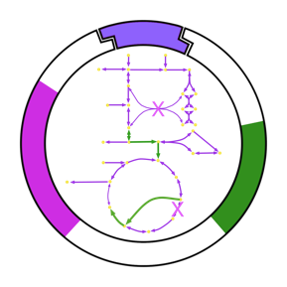


Balancing Machine Learning and First-Principles Modeling for Enhanced Biological Insights
Rajib Saha
Richard L. and Carol S. McNeel Associate Professor
Systems and Synthetic Biology Laboratory Department of Chemical and Biomolecular Engineering
University of Nebraska-Lincoln
sahassbio.com
@rsaha_phd
SSbioUNL

Slide 2
The Goals and Outputs of this Focus Area Session
Goals:
- Brainstorm & identify community-scale synthesis opportunities that you are interested in
- Catalyze the formation of nascent teams to write 2-page proto-proposal by end of summit
Output: Groups of participants will
- Identify specific questions/methods that are primed for community-scale synthesis
- Explain the significance of the question/method and its potential impact
- Explore forming a nascent team to draft a proto-proposal (bonus
although not expected or required, as there are other sessions to take part in)
Constraints:
- Proto-proposal teams cannot have more than 4 PIs, and require a minimum of 2 PIs
- Participants can only be listed on one proto-proposal

Slide 3
Schedule for your Focus Area Session
Time | Description | Duration (min)
0:00 - 0:15 | Introduction: Brief introduction by the Session Lead(s) giving an overview of the format, goals, and the topic of the session. The overall topic area and direction of field will be described. | 15
0:15 - 0:45 | Breakout Brainstorm: Participants are randomly split into groups (limit of 5 max) to generate community-scale synthesis research questions related to the Focus Area topic. Each group member gets one vote to put towards a question that they would personally like to work on. The top two questions are submitted via Google Forms/Qualtrics. | 30
0:45 - 0:55 | Break: Participants get a 10-min break while lead(s) evaluate the questions submitted to remove duplicates. | 10
0:55 - 1:00 | Question Evaluation: Participants will look at all questions that emerge from the Breakout Brainstorm section and go to a question on which they are interested in working. Focus Area leads will help determine the areas to which those who want to work on different questions should go within the room. | 5
1:00 - 1:45 | Exploration: Participants discuss the questions and see if there is alignment; if there is not, move to another question of interest or start another group on a more focused approach to the question. Every 15 minutes, participants will be encouraged to look for another question of interest, but it is up to them to decide if they want to stick with the current option, explore other questions, or join the open discussion. | 45
1:45 - 2:00 | Convergence: Participants make a final decision on if there's a question around which they would like to form a nascent team. It is okay not to have a team or question(s) of interest, as there are other sessions. If participants want to lock-in this group, they may start the proto-proposal writing process. | 15

Slide 4
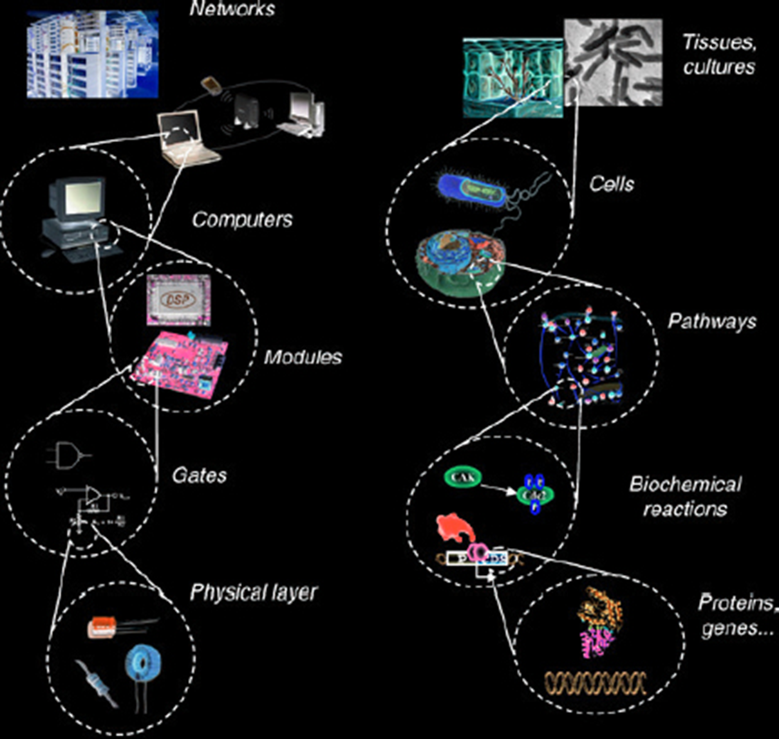
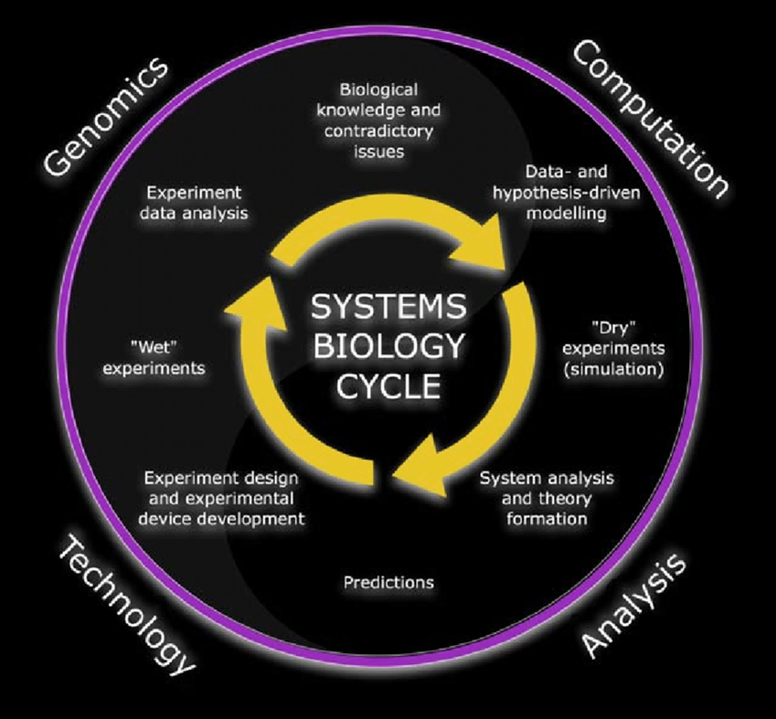
What is Systems Biology?
“Biological insight emerges when we model the whole — not just the parts”
From Circuits to Cells: The Language of Systems
The Iterative Cycle of Systems Biology
Systems biology unifies experimental data, computation, and theory to predict and design biological function.

Slide 5
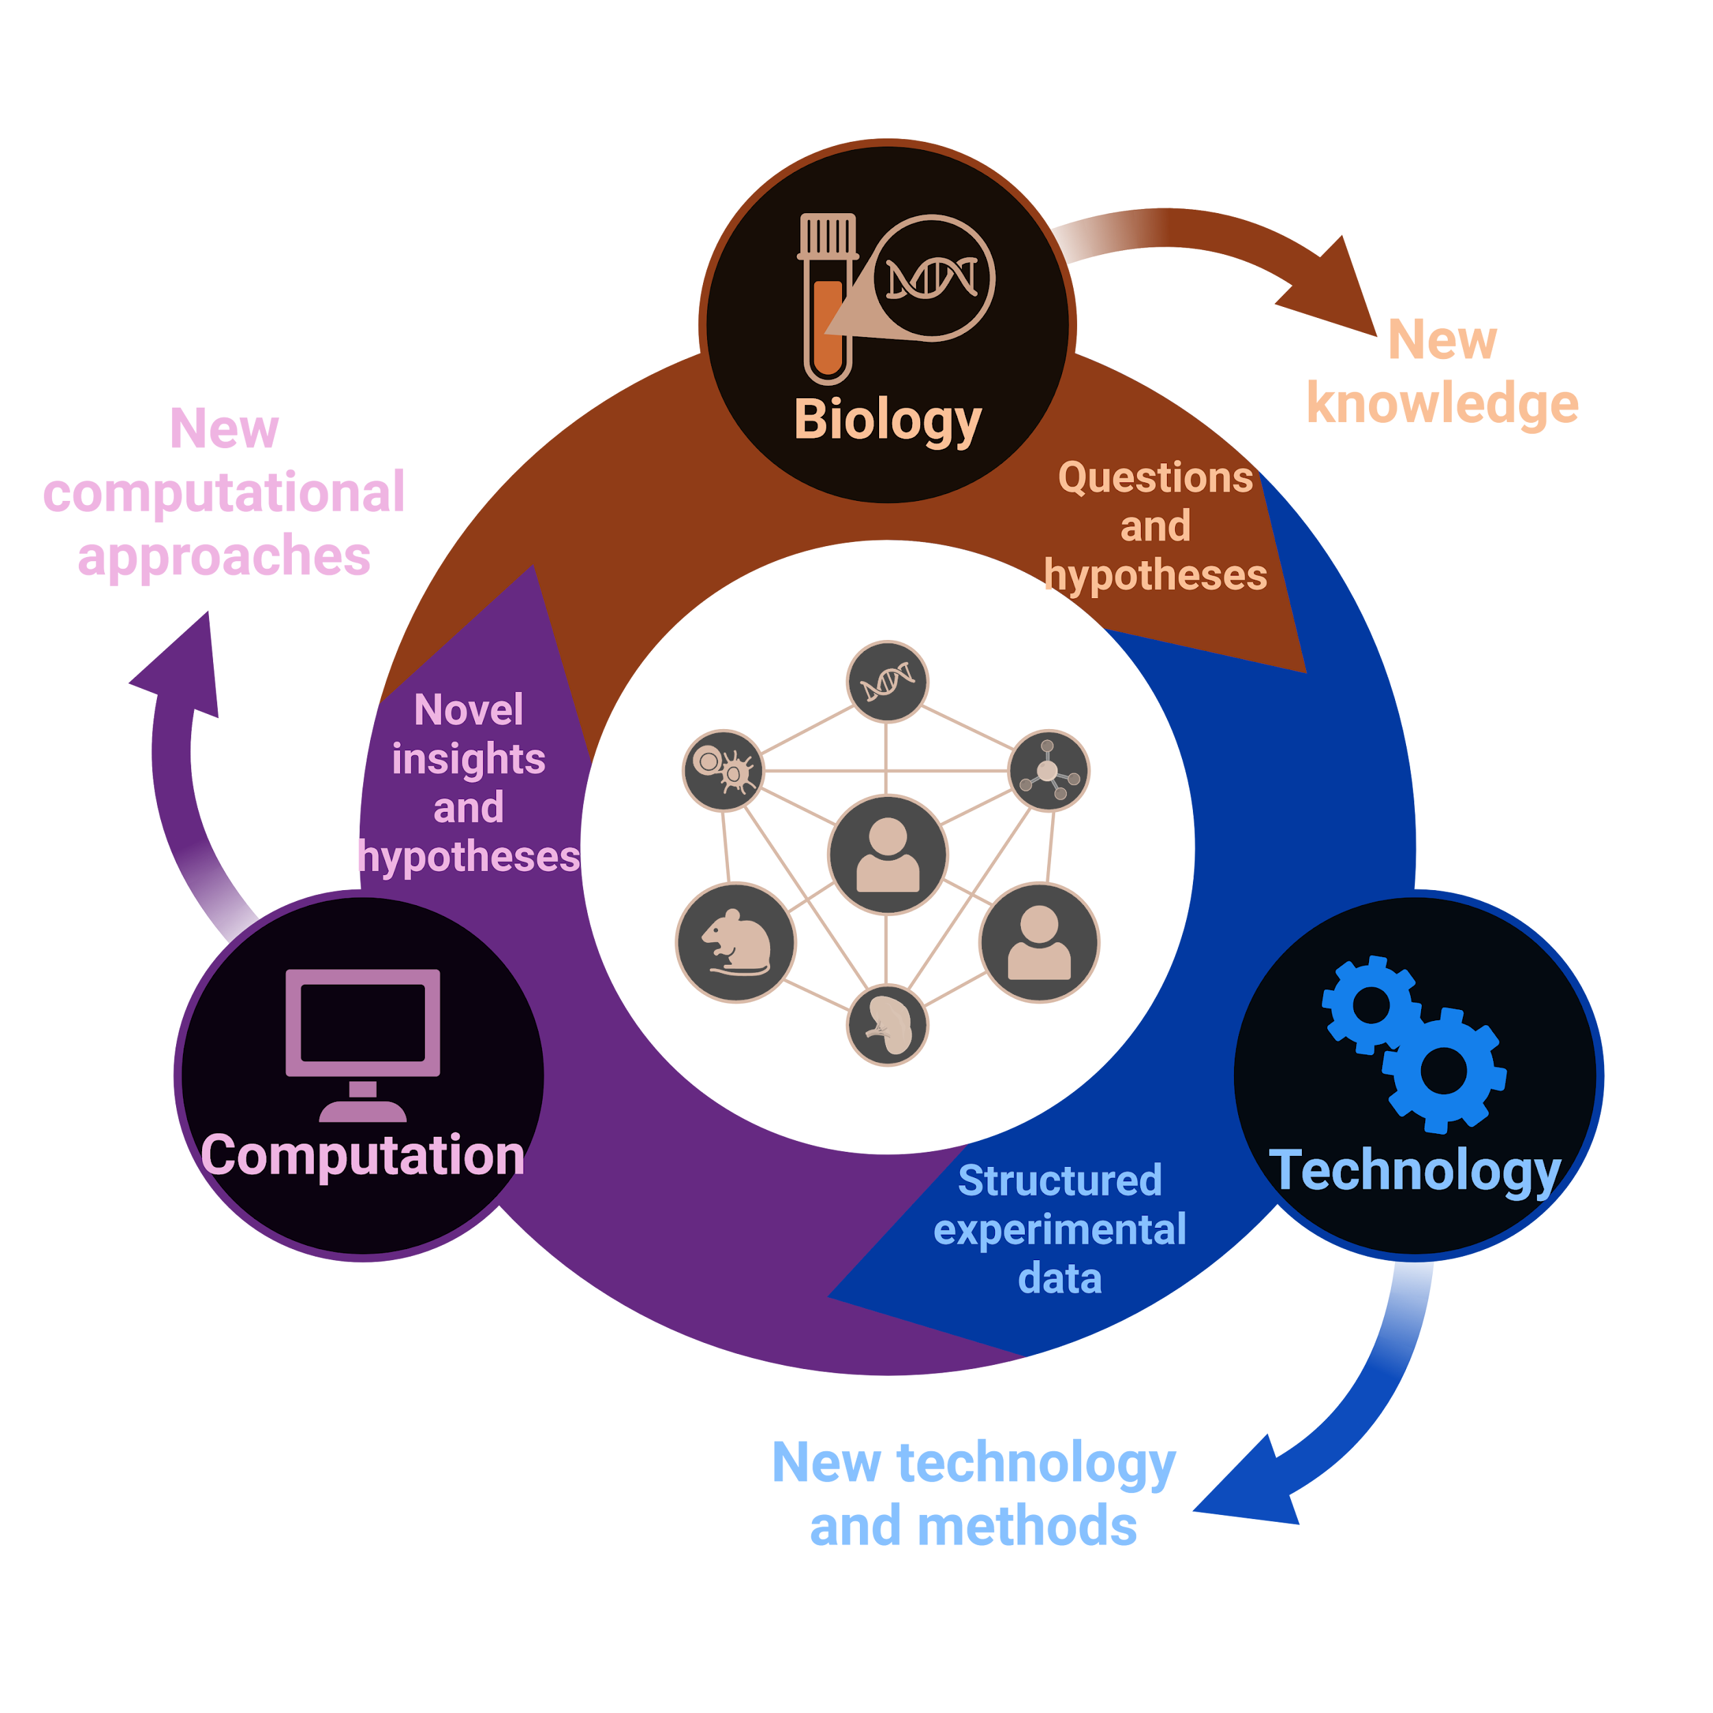
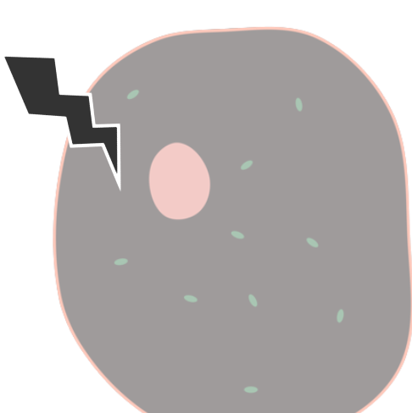
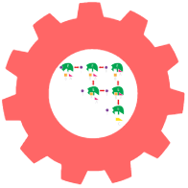
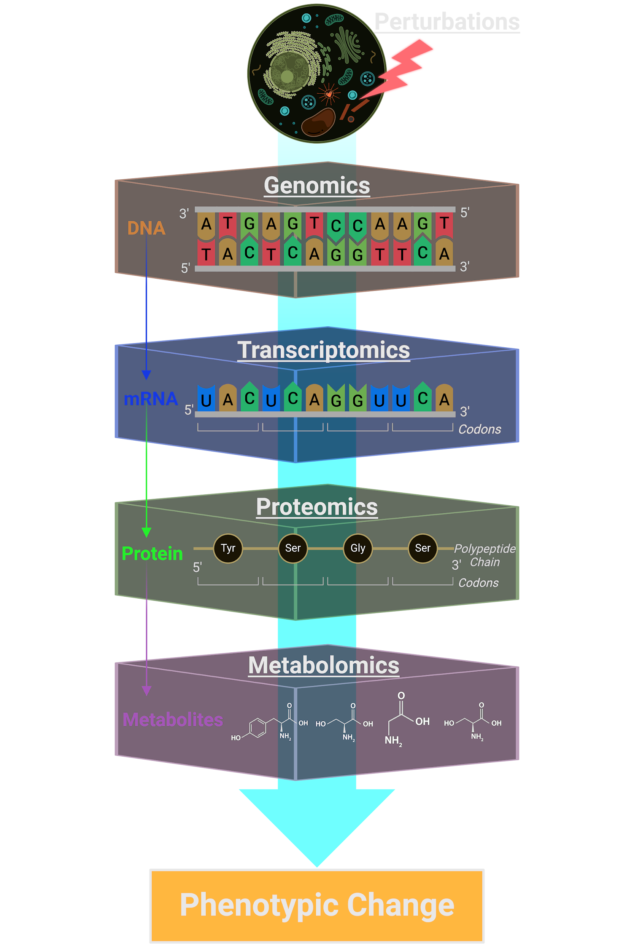

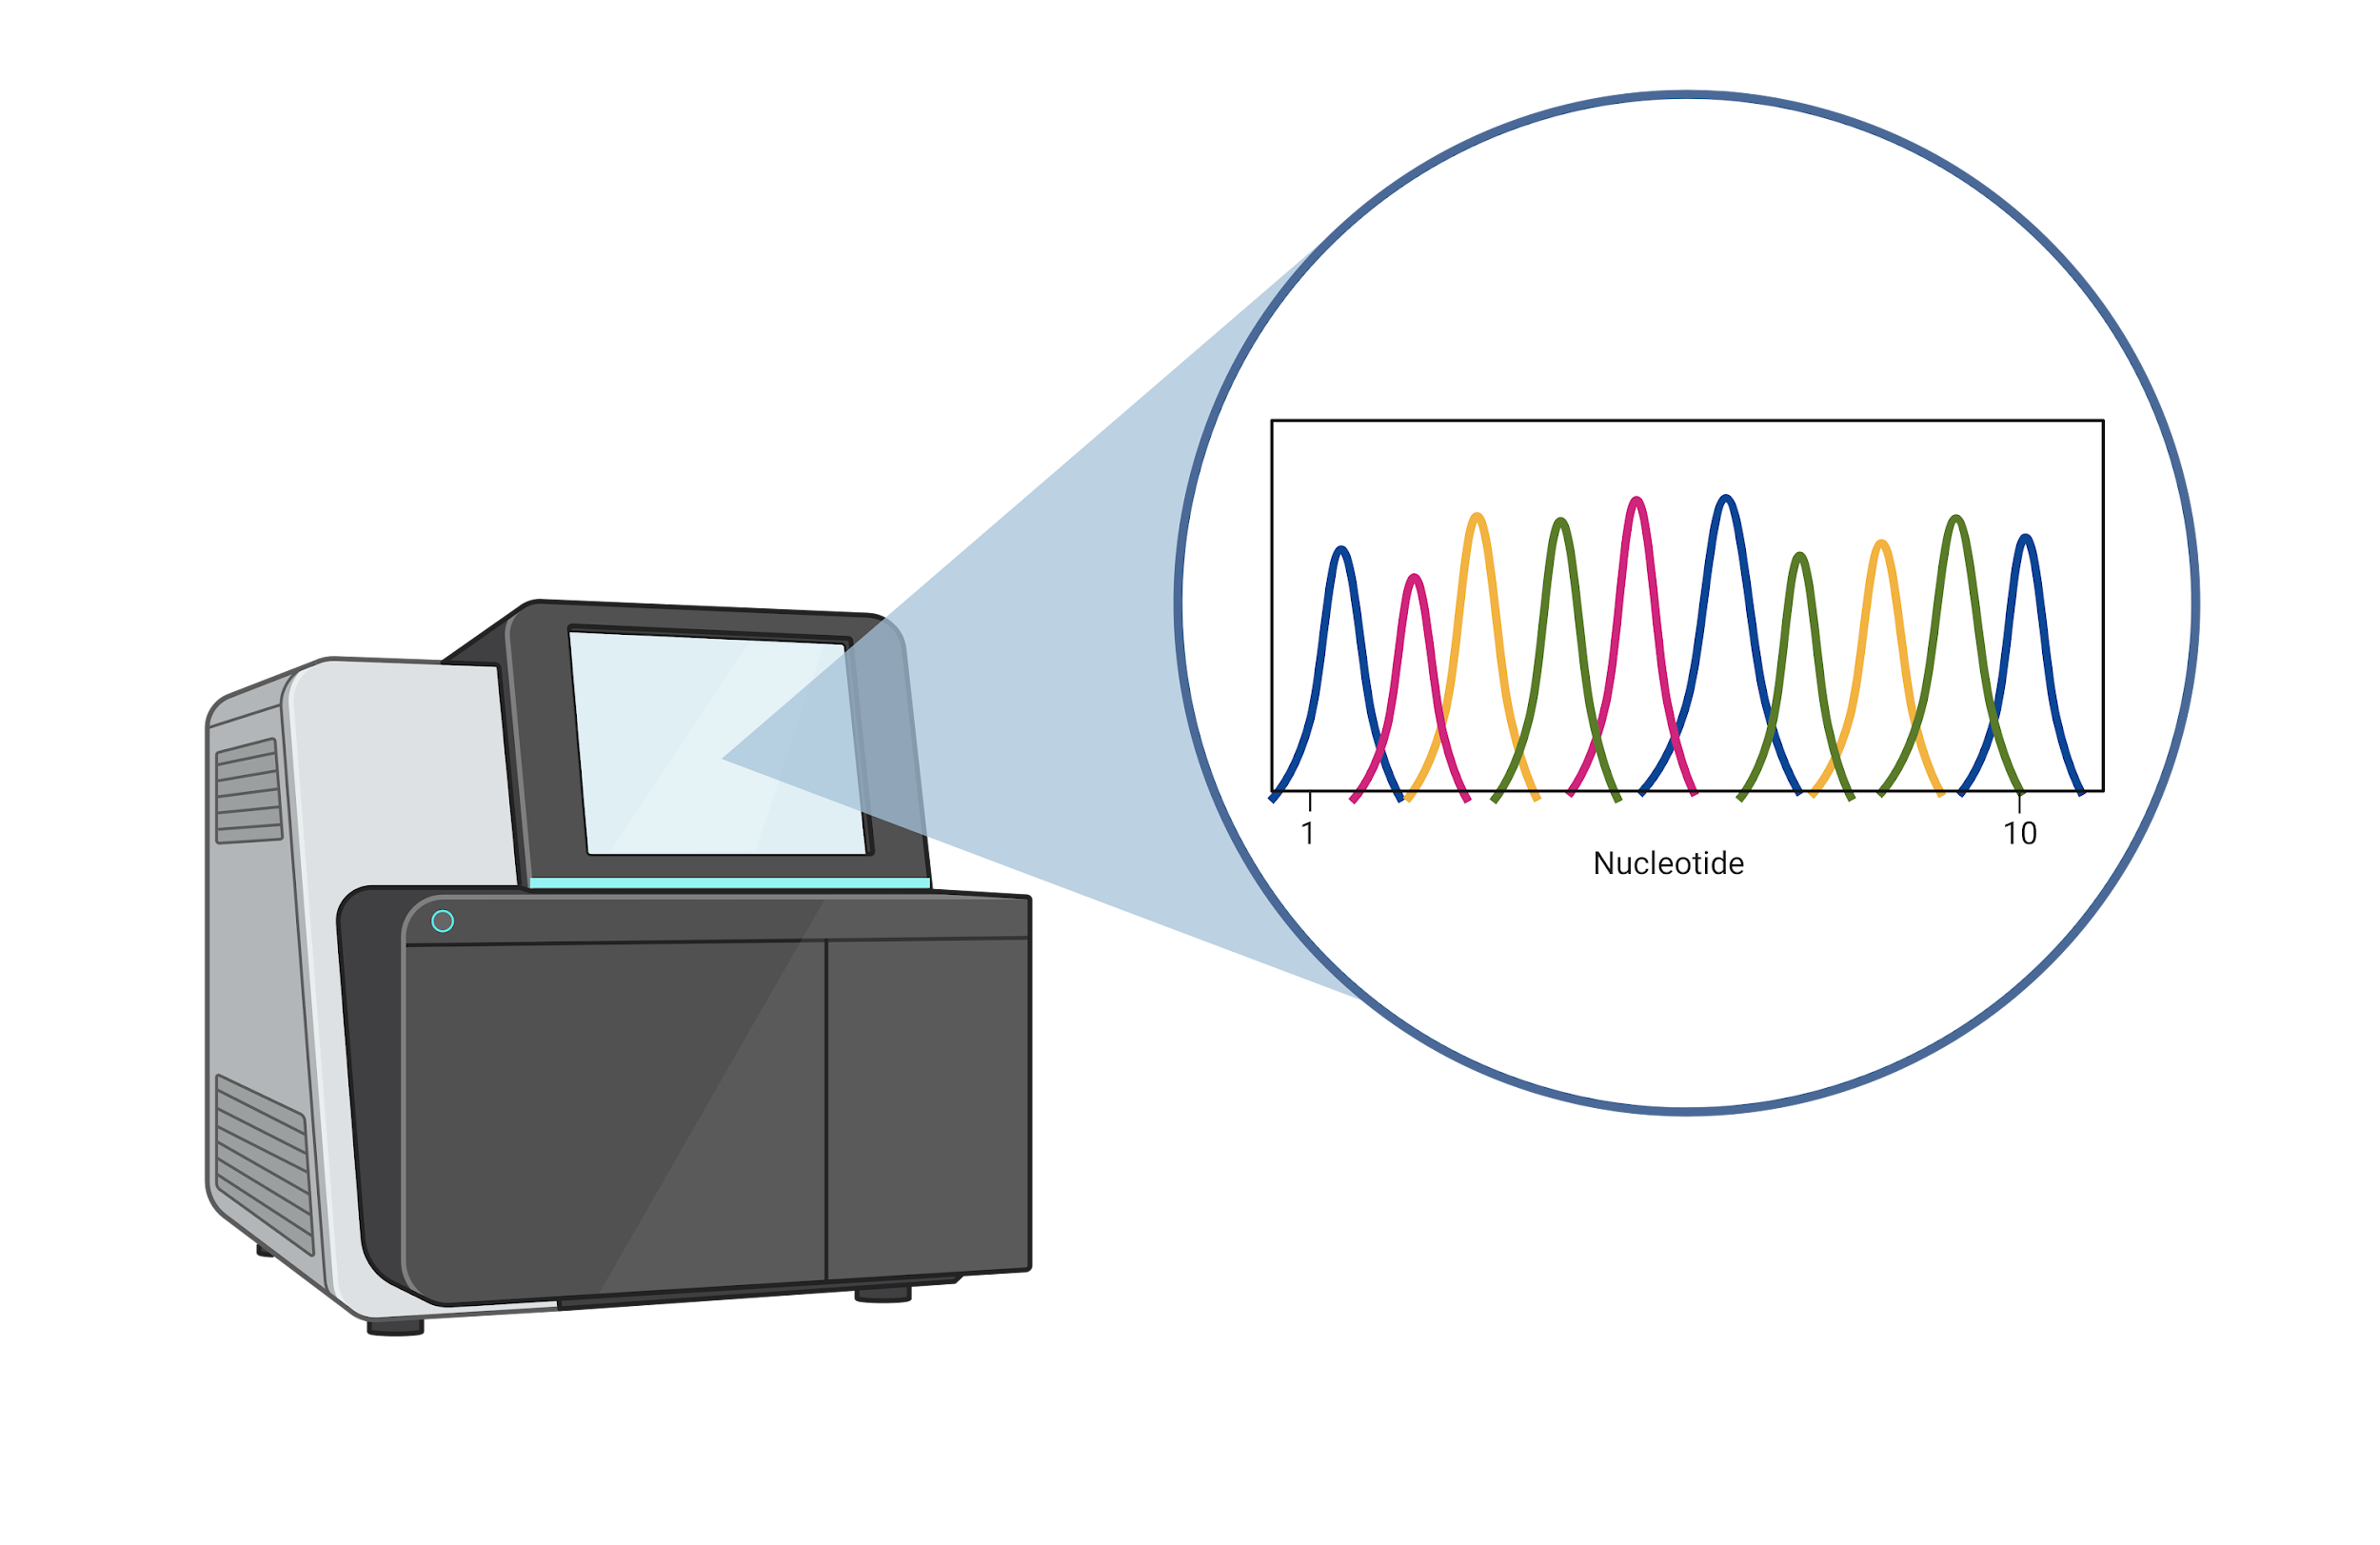



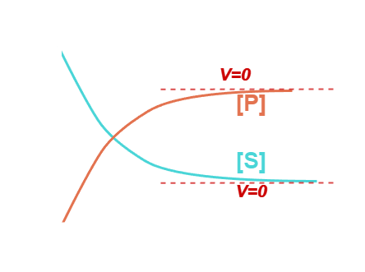
The Ultimate Goal of Systems Biology
© Institute for Systems Biology
Accurate prediction of cellular phenotype under any condition
Images created with Biorender
Villa and Sonis, Acad. Press Elsevier, (2020).

Slide 6
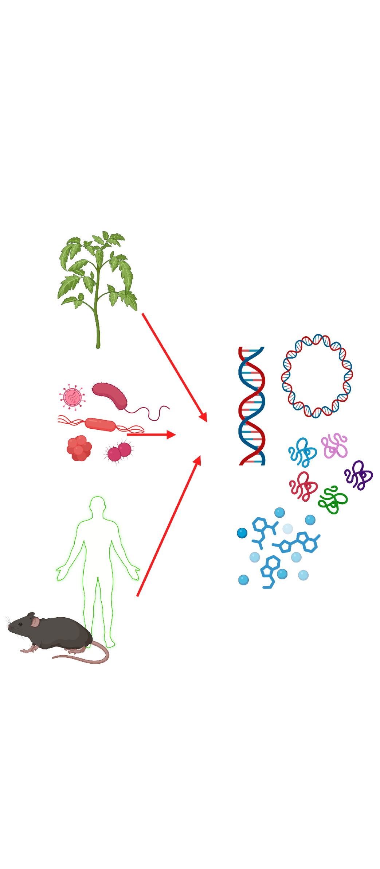
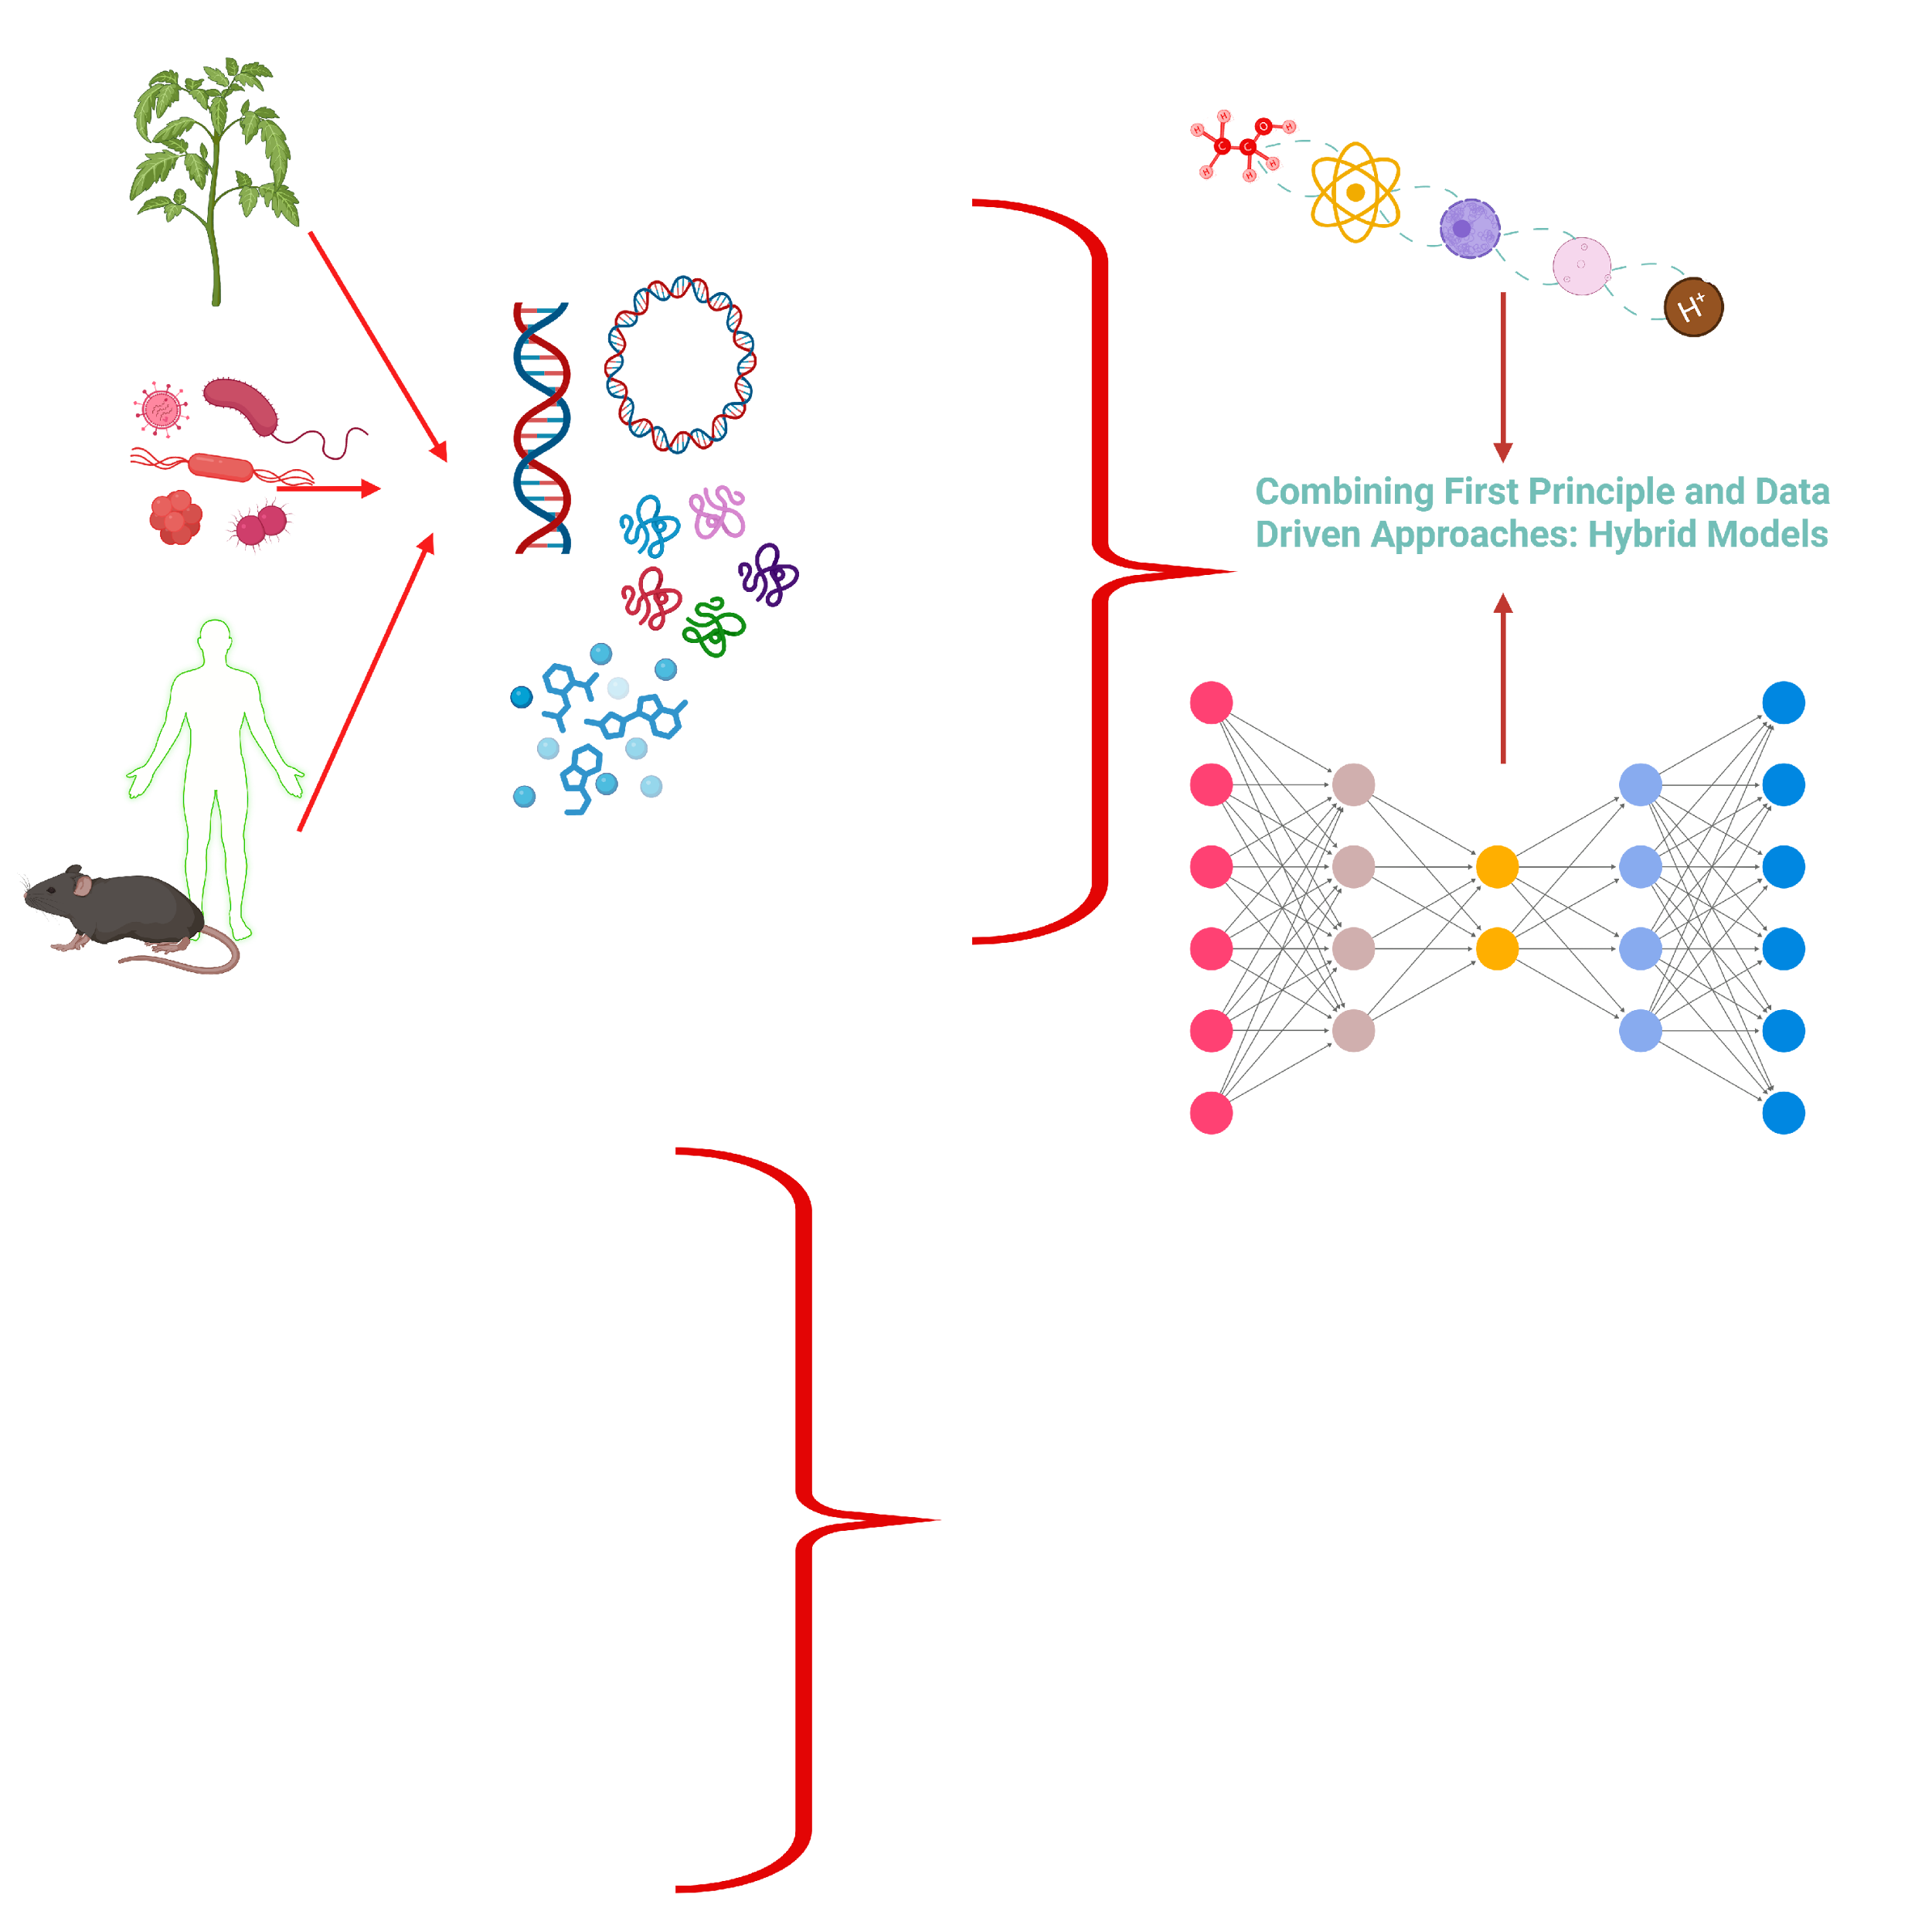
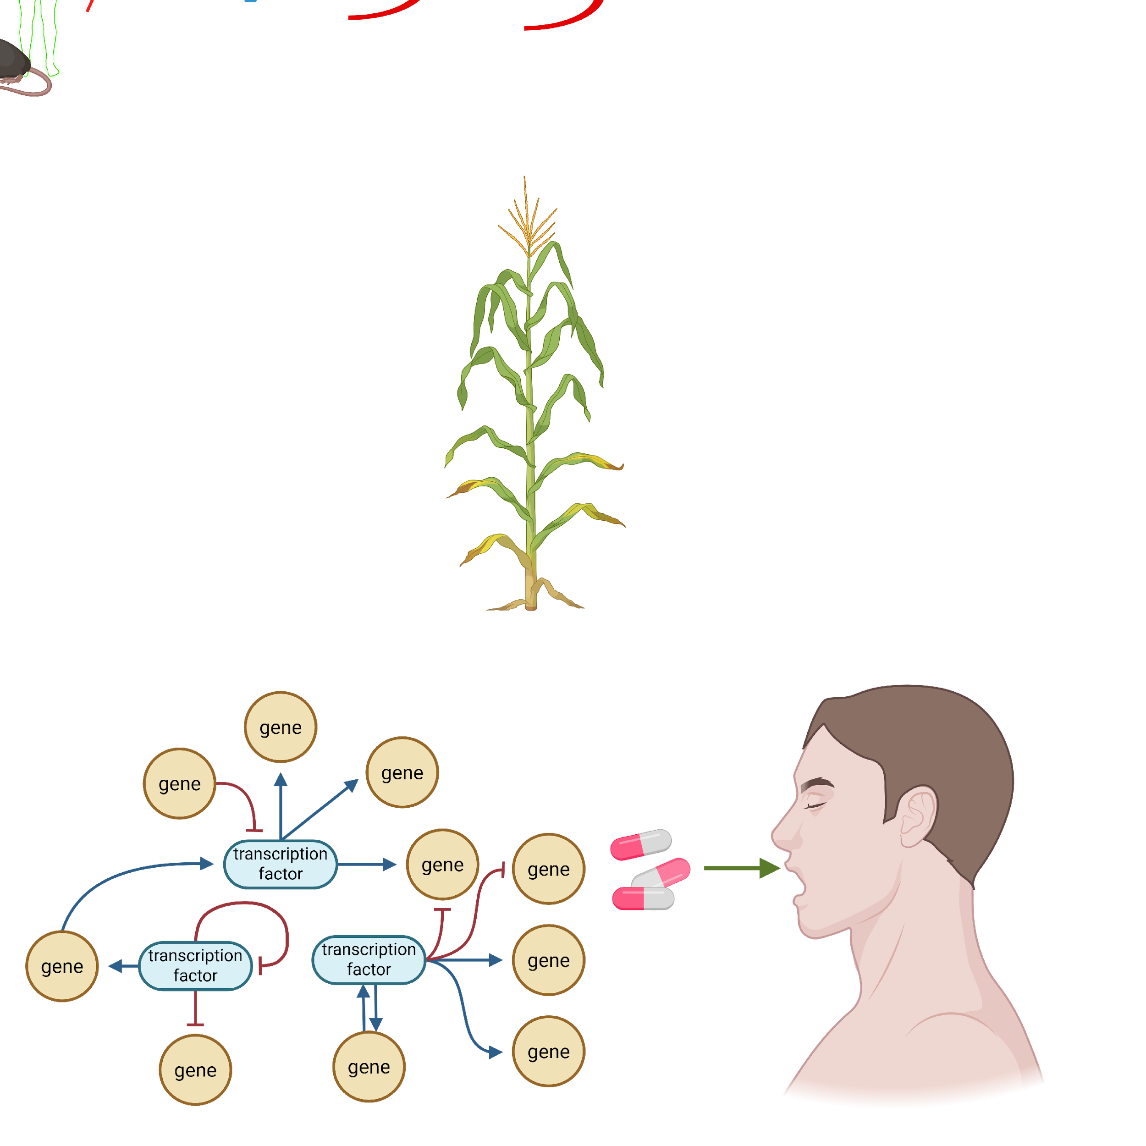

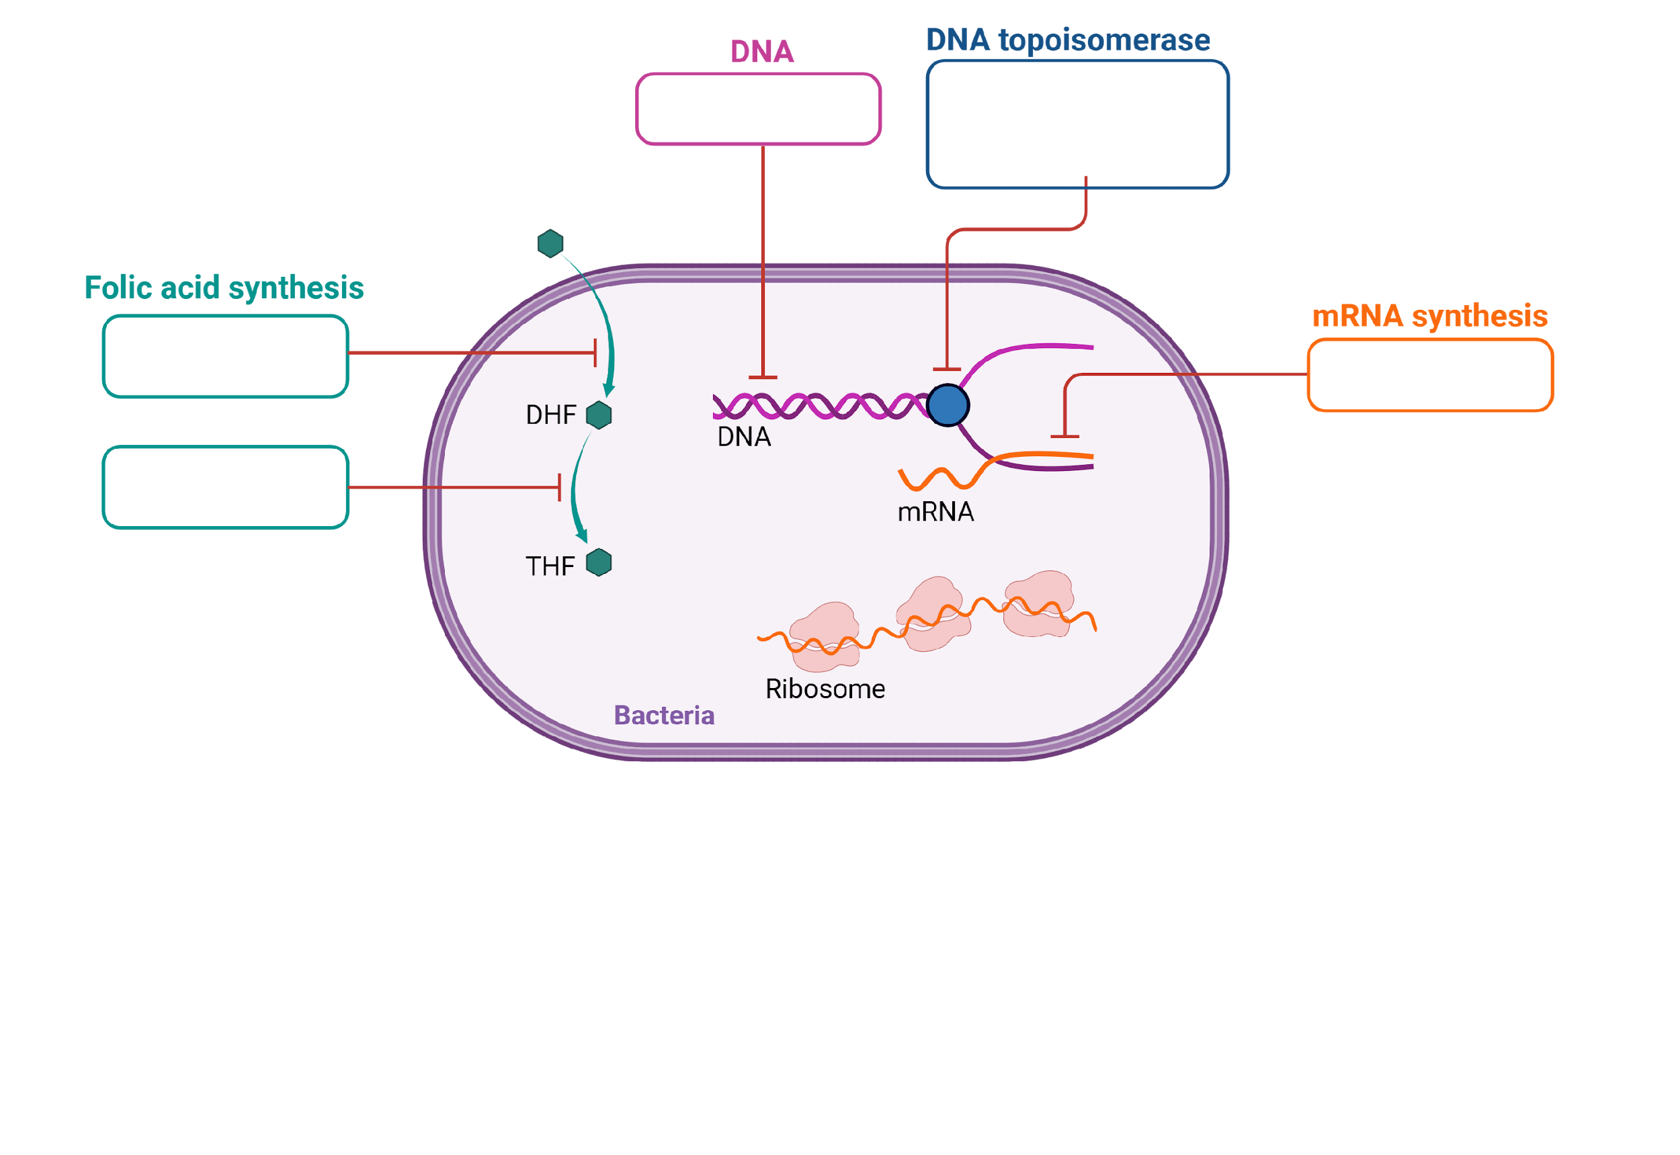
Cellular Phenotypes: How We Get There?
Computational Predictions
Biological Systems
Phenotype Predictions (e.g. growth,…)
Anti-Microbial Strategies
Genetic Regulations
Drug Discovery
….
Data Generation (e.g., Omics)
Systems Biology: Computational Predictions

Slide 7
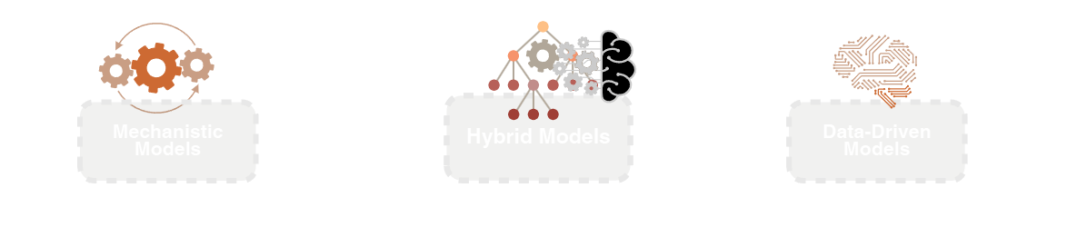
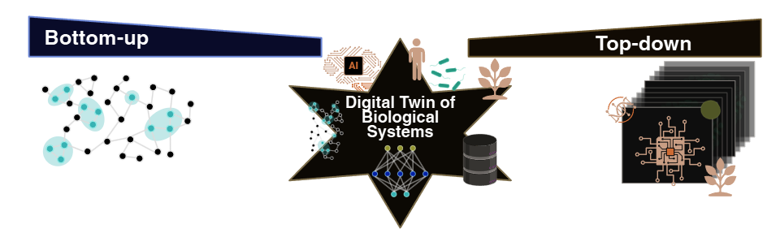
How We Get There: Modeling Approaches in Systems Biology
First-principles models (Stoichiometry, ODEs)
Network reconstructions
Metabolic constraint-based models:
GSMs (Genome-scale models)
ME-models (Metabolic expression models)
K-models (Kinetic models)
Predict system-wide fluxes
ML integrated with first-principles models
ML-constrained GSMs, GSMs informed ML
Data augmentation for GSMs
Surrogate modeling + parameter inference
DBTL (Design-Build-Test-Learn) workflows
Adaptive & context-aware simulations
ML/DL on omics and phenotypic data
Dimensionality reduction (PCA, embeddings)
Classification & regression (expression, phenotype)
Reinforcement & statistical learning
Feature engineering + clustering
Building Toward Digital Twins through Bottom-Up, Top-Down, and Hybrid Paths
Each path contributes uniquely — but together, they define a Digital Twin that links data, models, and phenotype prediction.

Slide 8
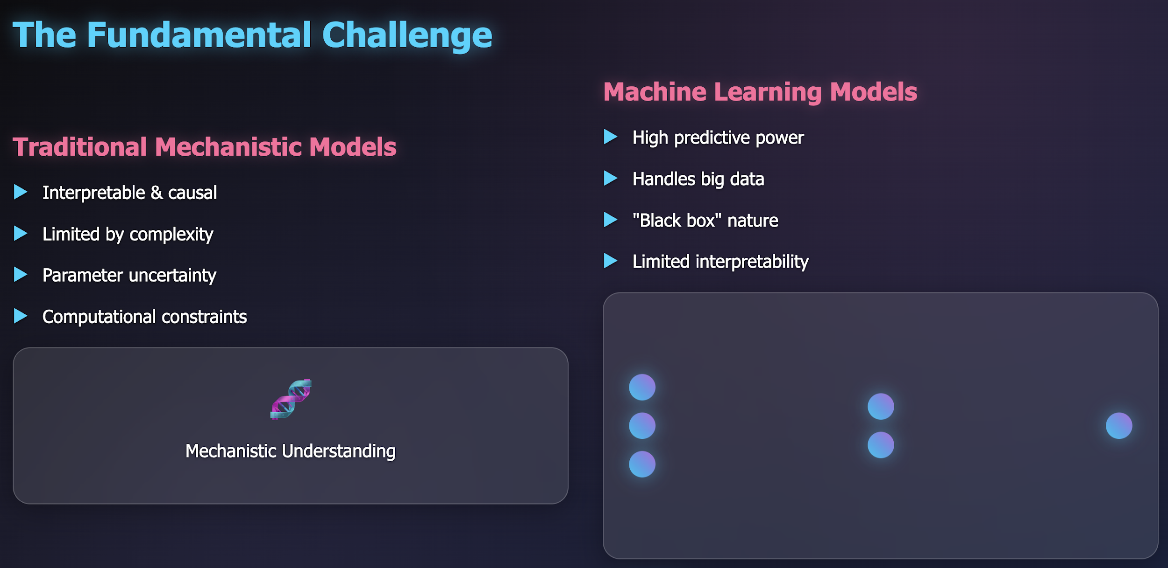
The Fundamental Challenge

Slide 9
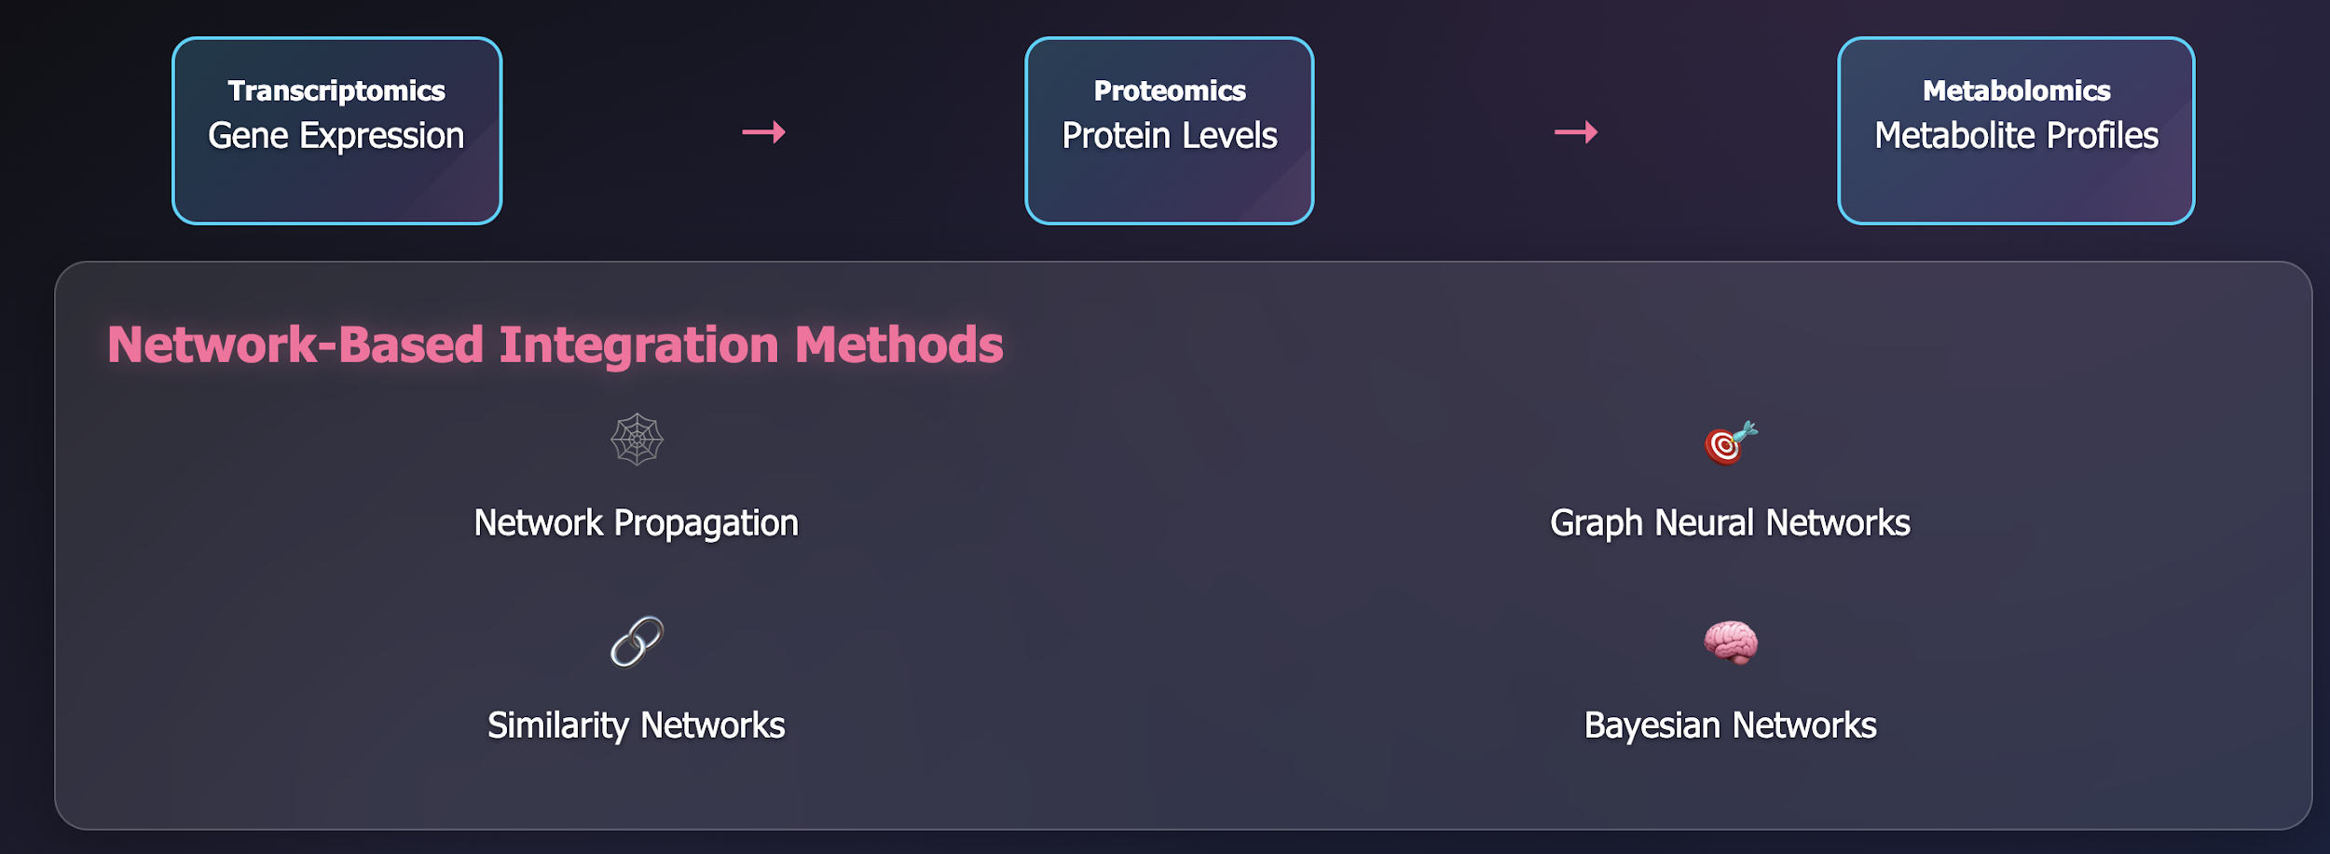
Multi-Omics Data Integration

Slide 10
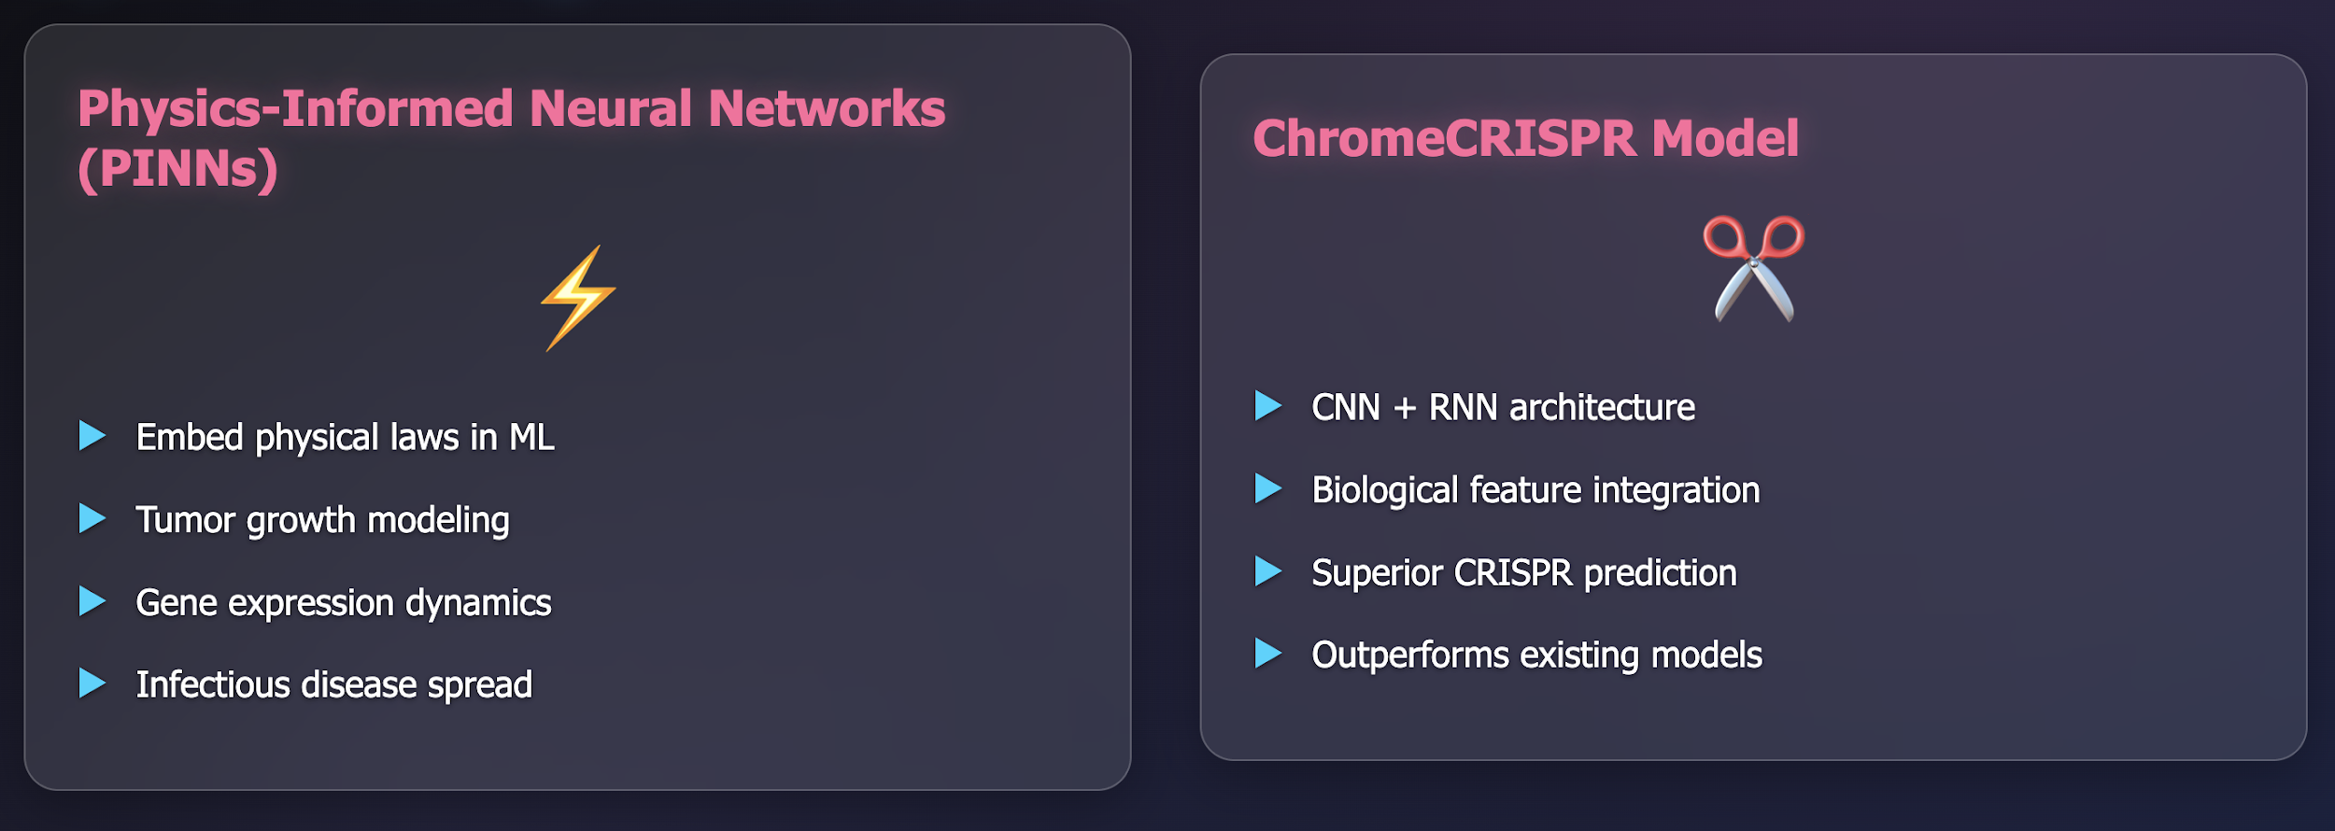
Hybrid Modelling Success Stories

Slide 11
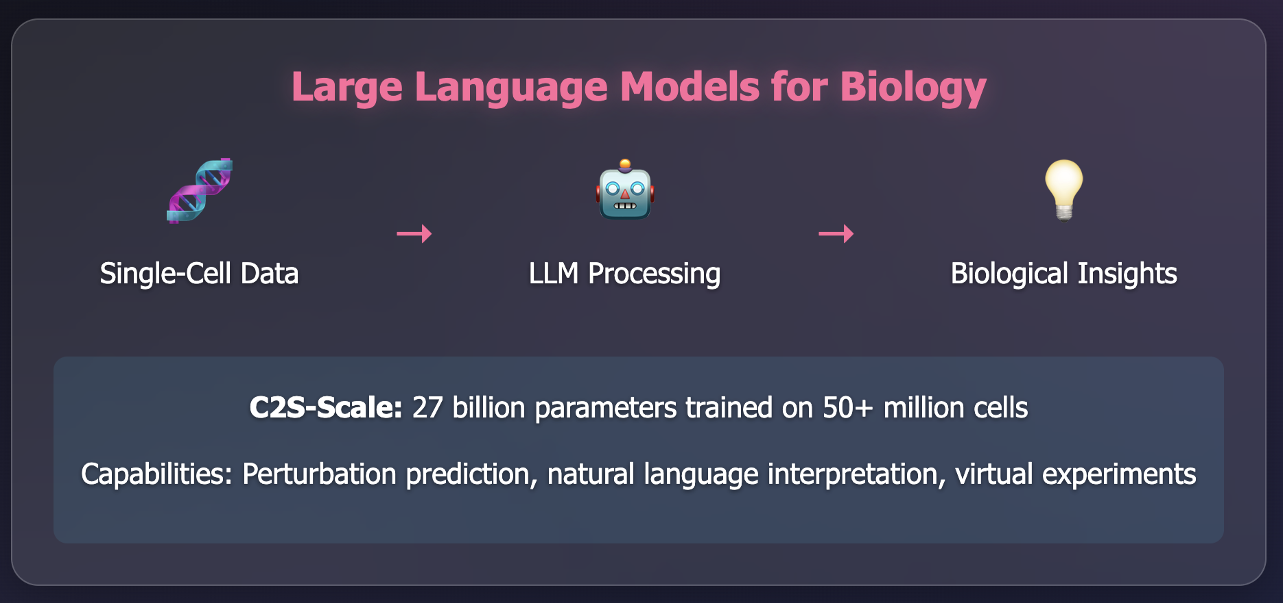
AI-Powered Virtual Cells

Slide 12
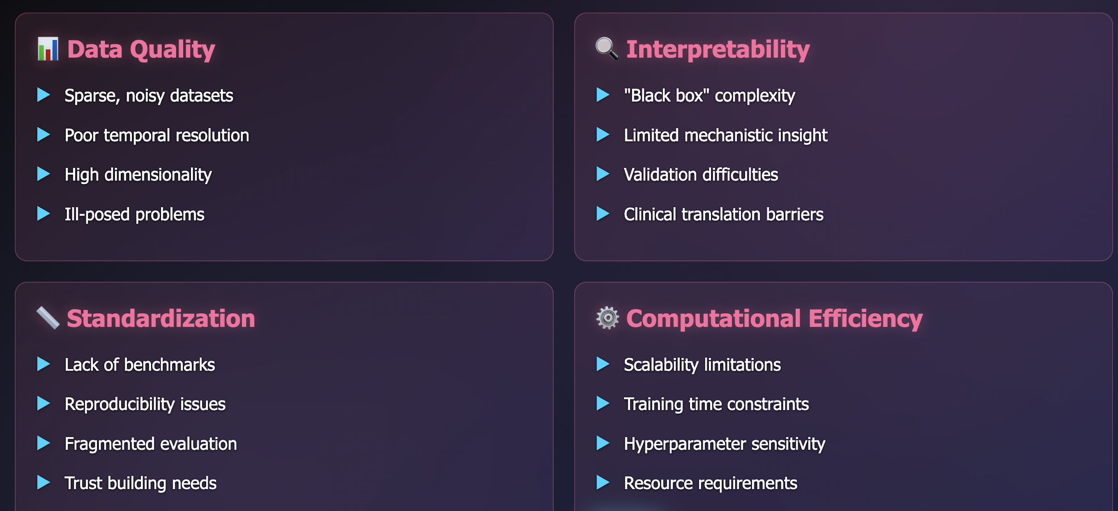
Persistent Challenges

Slide 13
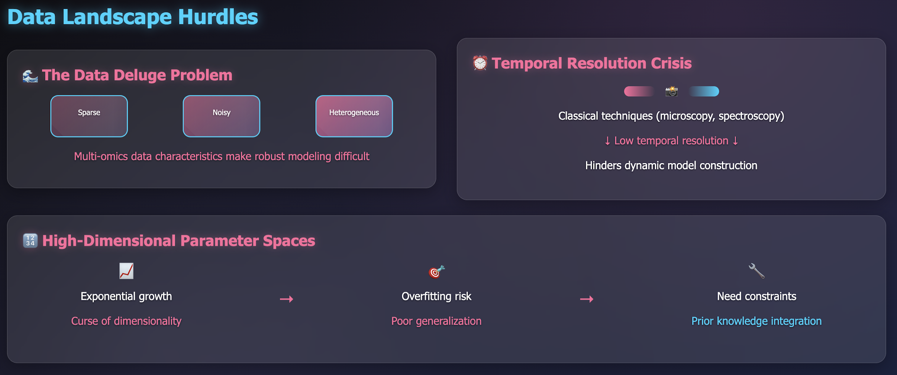
Data Landscape Hurdles

Slide 14
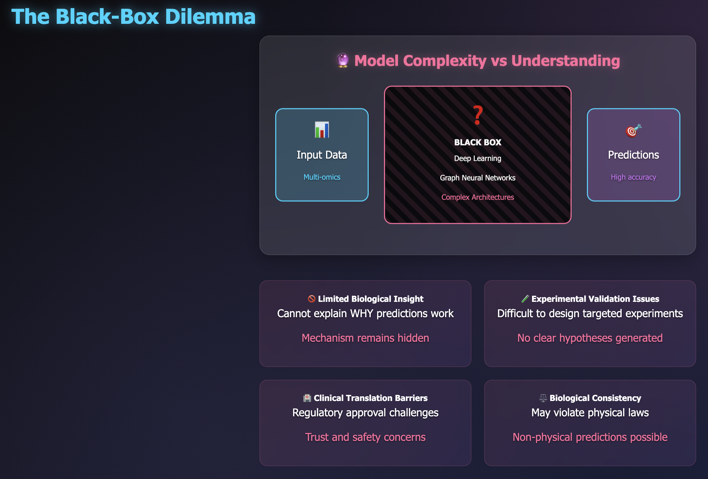
The Black-Box Dilemma

Slide 15
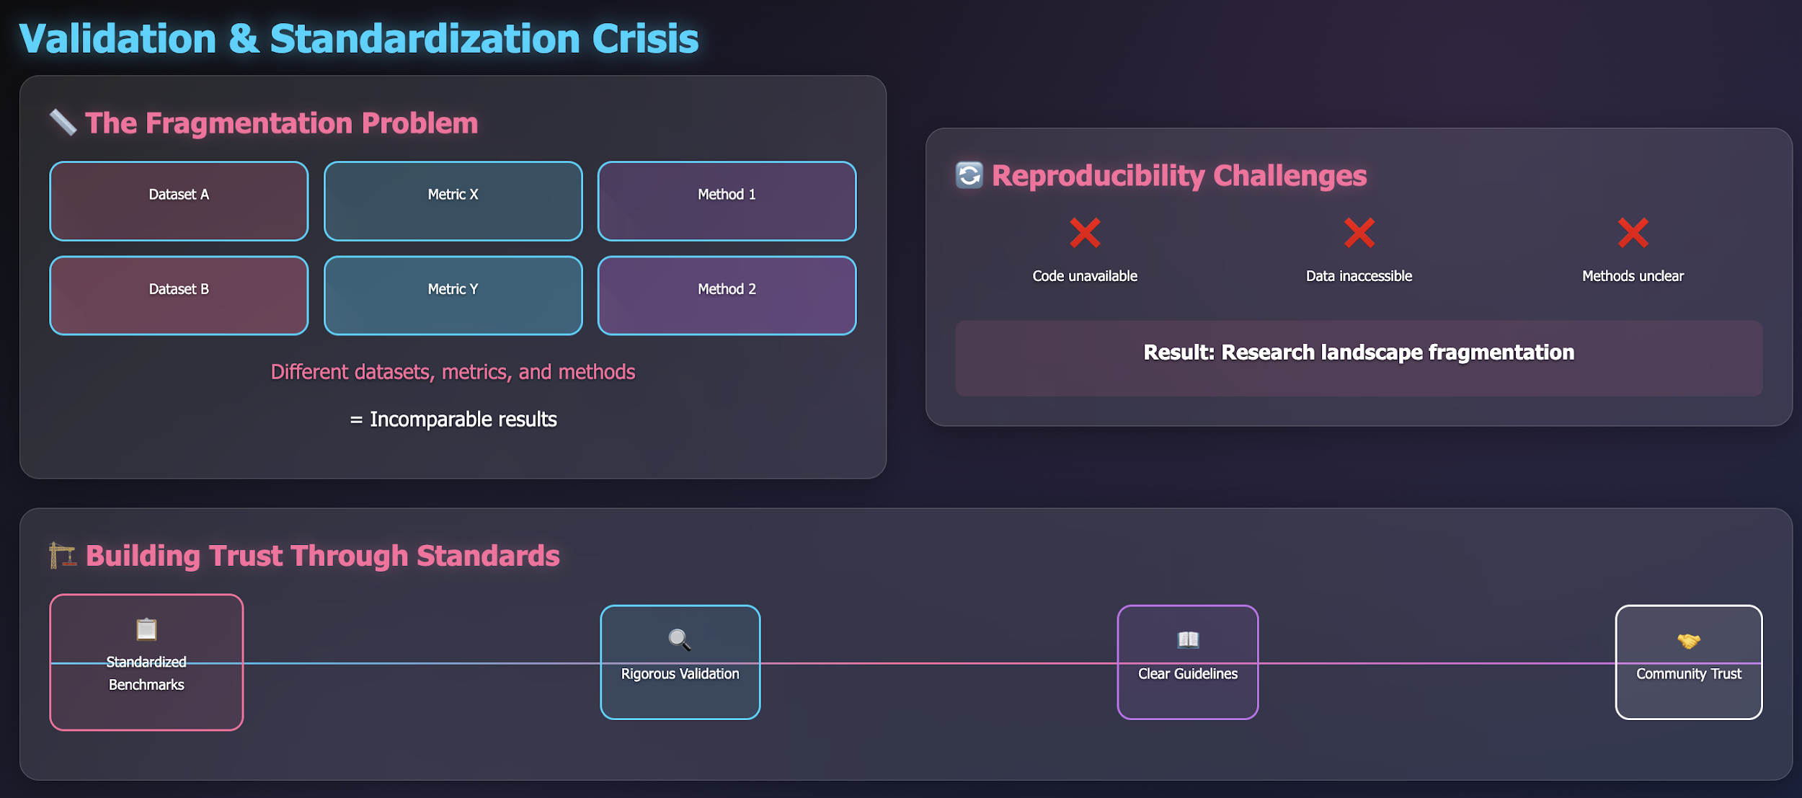
Validation & Standardization Crisis

Slide 16
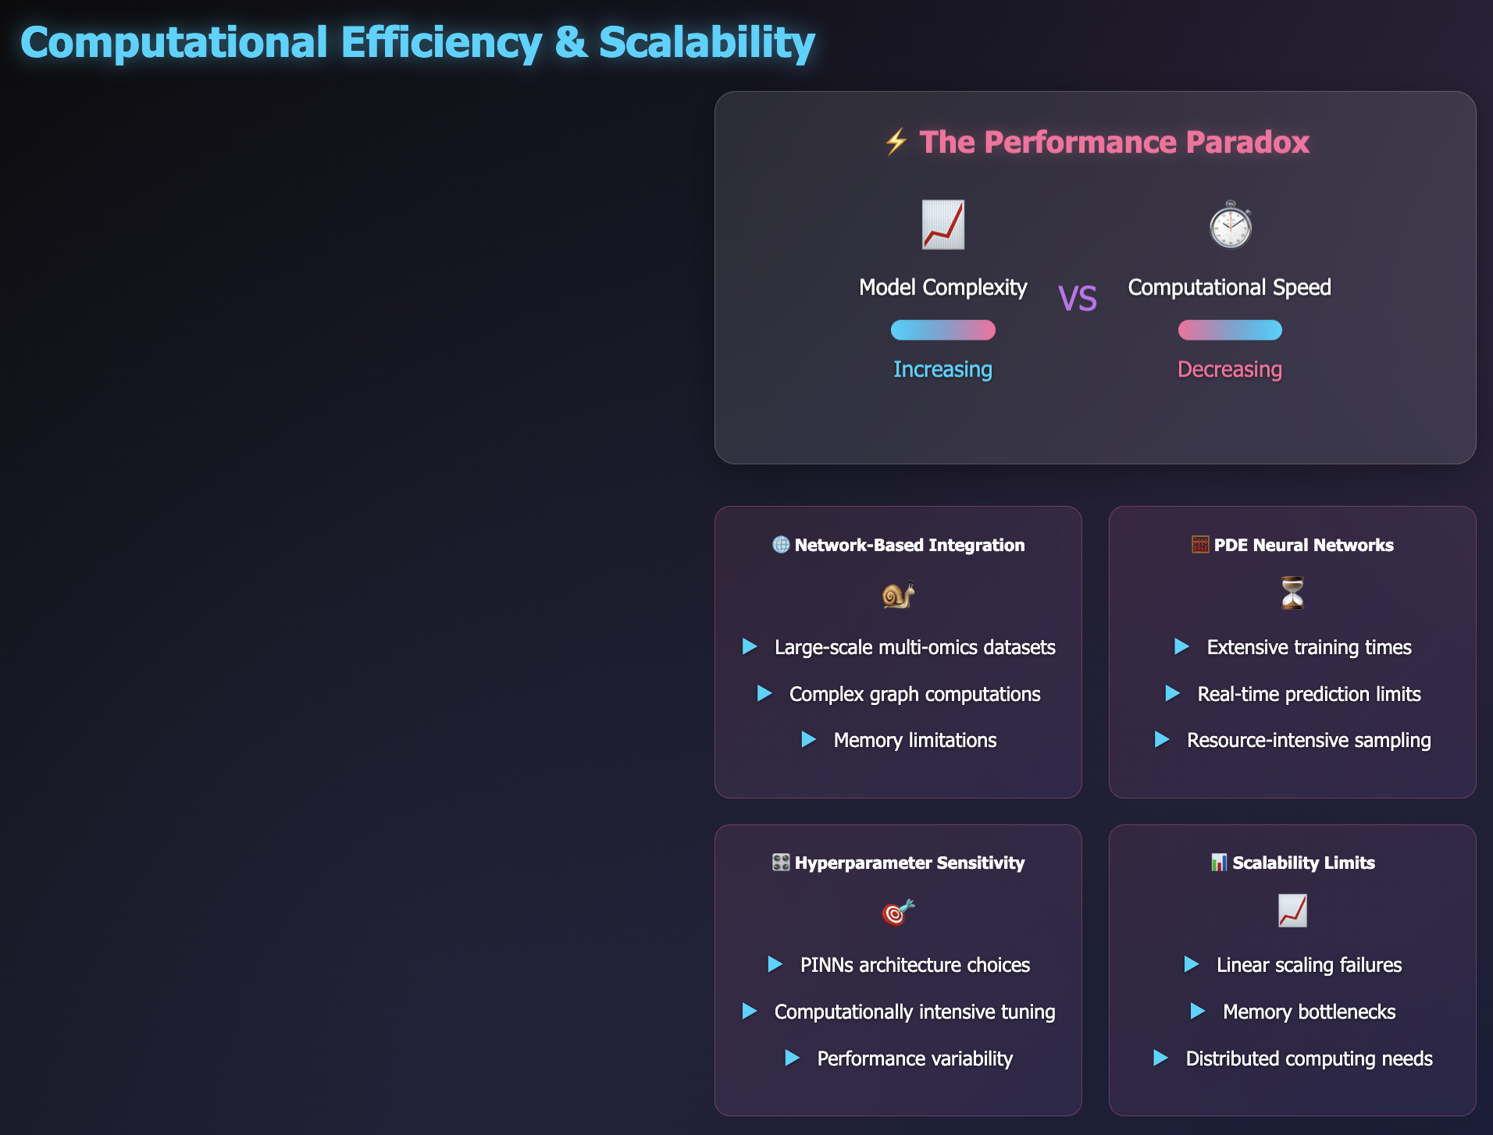
Computational Efficiency & Scalability

Slide 17
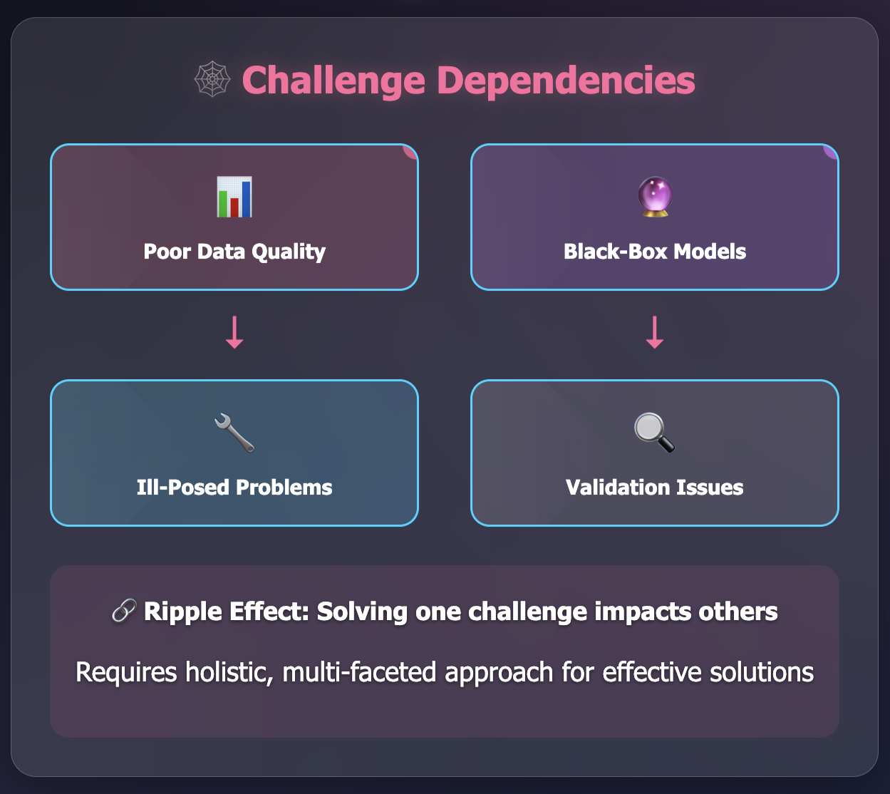
The Interconnected Web of Challenges

Slide 18
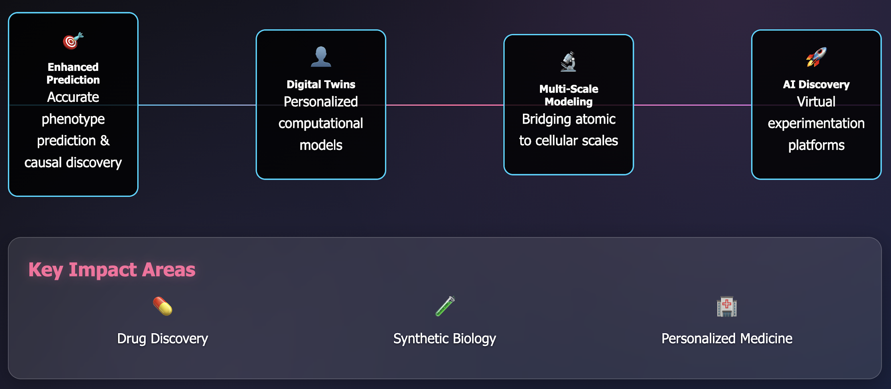
Opportunities on the Horizon

Slide 19
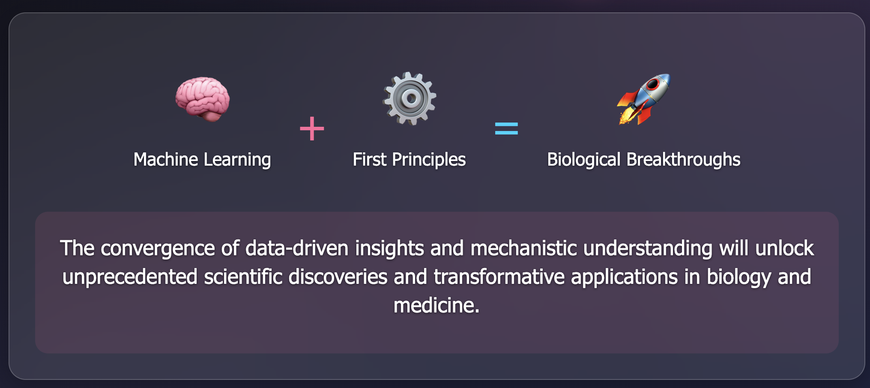
The Future is Integrated.

Slide 20


Thank You!

Slide 21
Schedule for your Focus Area Session
Time | Description | Duration (min)
0:00 - 0:15 | Introduction: Brief introduction by the Session Lead(s) giving an overview of the format, goals, and the topic of the session. The overall topic area and direction of field will be described. | 15
0:15 - 0:45 | Breakout Brainstorm: Participants are randomly split into groups (limit of 5 max) to generate community-scale synthesis research questions related to the Focus Area topic. Each group member gets one vote to put towards a question that they would personally like to work on. The top two questions are submitted via Google Forms/Qualtrics. | 30
0:45 - 0:55 | Break: Participants get a 10-min break while lead(s) evaluate the questions submitted to remove duplicates. | 10
0:55 - 1:00 | Question Evaluation: Participants will look at all questions that emerge from the Breakout Brainstorm section and go to a question on which they are interested in working. Focus Area leads will help determine the areas to which those who want to work on different questions should go within the room. | 5
1:00 - 1:45 | Exploration: Participants discuss the questions and see if there is alignment; if there is not, move to another question of interest or start another group on a more focused approach to the question. Every 15 minutes, participants will be encouraged to look for another question of interest, but it is up to them to decide if they want to stick with the current option, explore other questions, or join the open discussion. | 45
1:45 - 2:00 | Convergence: Participants make a final decision on if there's a question around which they would like to form a nascent team. It is okay not to have a team or question(s) of interest, as there are other sessions. If participants want to lock-in this group, they may start the proto-proposal writing process. | 15

Slide 22
Schedule for your Focus Area Session
Time | Description | Duration (min)
0:00 - 0:15 | Introduction: Brief introduction by the Session Lead(s) giving an overview of the format, goals, and the topic of the session. The overall topic area and direction of field will be described. | 15
0:15 - 0:45 | Breakout Brainstorm: Participants are randomly split into groups (limit of 5 max) to generate community-scale synthesis research questions related to the Focus Area topic. Each group member gets one vote to put towards a question that they would personally like to work on. The top two questions are submitted via Google Forms/Qualtrics. | 30
0:45 - 0:55 | Break: Participants get a 10-min break while lead(s) evaluate the questions submitted to remove duplicates. | 10
0:55 - 1:00 | Question Evaluation: Participants will look at all questions that emerge from the Breakout Brainstorm section and go to a question on which they are interested in working. Focus Area leads will help determine the areas to which those who want to work on different questions should go within the room. | 5
1:00 - 1:45 | Exploration: Participants discuss the questions and see if there is alignment; if there is not, move to another question of interest or start another group on a more focused approach to the question. Every 15 minutes, participants will be encouraged to look for another question of interest, but it is up to them to decide if they want to stick with the current option, explore other questions, or join the open discussion. | 45
1:45 - 2:00 | Convergence: Participants make a final decision on if there's a question around which they would like to form a nascent team. It is okay not to have a team or question(s) of interest, as there are other sessions. If participants want to lock-in this group, they may start the proto-proposal writing process. | 15

Slide 23
Schedule for your Focus Area Session
Time | Description | Duration (min)
0:00 - 0:15 | Introduction: Brief introduction by the Session Lead(s) giving an overview of the format, goals, and the topic of the session. The overall topic area and direction of field will be described. | 15
0:15 - 0:45 | Breakout Brainstorm: Participants are randomly split into groups (limit of 5 max) to generate community-scale synthesis research questions related to the Focus Area topic. Each group member gets one vote to put towards a question that they would personally like to work on. The top two questions are submitted via Google Forms/Qualtrics. | 30
0:45 - 0:55 | Break: Participants get a 10-min break while lead(s) evaluate the questions submitted to remove duplicates. | 10
0:55 - 1:00 | Question Evaluation: Participants will look at all questions that emerge from the Breakout Brainstorm section and go to a question on which they are interested in working. Focus Area leads will help determine the areas to which those who want to work on different questions should go within the room. | 5
1:00 - 1:45 | Exploration: Participants discuss the questions and see if there is alignment; if there is not, move to another question of interest or start another group on a more focused approach to the question. Every 15 minutes, participants will be encouraged to look for another question of interest, but it is up to them to decide if they want to stick with the current option, explore other questions, or join the open discussion. | 45
1:45 - 2:00 | Convergence: Participants make a final decision on if there's a question around which they would like to form a nascent team. It is okay not to have a team or question(s) of interest, as there are other sessions. If participants want to lock-in this group, they may start the proto-proposal writing process. | 15

Slide 24
Focus Area Session Questions
What is the potential of multi-agent AI systems (e.g., AlphaFold) in pathway prediction for target molecules? How to integrate the results using databases such as NCBI, PubMed, …
How can ML/AI explain causal gene interactions/relationships in feedback loops/networks in perturbation-based cell measurements?
Can we use AI/ML to correlate SNPs to gene expression (transcriptomics and translatomics) and futher metabolic changes (metabolomics) changes?
given the sequence of mitrocondrial and nuclear DNA in a cell, the spatial distribution of proteins within organelles, and cellular environment (temperature, PH, etc), can you predict turnover of mitrocondiral proteins?
Are textual-based LLMs sufficient to address prediction problems in biology? Or should we develop custom LLMs (e.g., vision-based) to better inform work on these projects?
Can ML/AI reconstruct the temporal history of individual organs or disease physiology using single timepoint blood omics for a given individual?
Can we correlate SNPs to changes in RNA structure (maybe SHAPE analysis) and RNA binding protein loci (CLIP-seq)?
starting from the exisitng kinetic models for mitrocondrial dynamics, can we use machine learning to make these models more expressive and better in predicting bioenergetics??
How can we leverage integrative multi-omics approaches (e.g., combining GWAS, proteomics, and metabolomics) to systematically identify the downstream metabolic consequences of mutations in mitochondrial proteins across different tissues?
How do perturbations in ion flux within a single organ—such as altered sodium, potassium, calcium, or proton gradients—translate into system-wide changes in metabolic homeostasis?
Biological Question: What can we learn from evolution and from the diversity of tissue structure on the molecular tools developed by nature to allow the physical and functional interactions of organelles, for example: mitochondria and lipid droplets

Slide 25
Schedule for your Focus Area Session
Time | Description | Duration (min)
0:00 - 0:15 | Introduction: Brief introduction by the Session Lead(s) giving an overview of the format, goals, and the topic of the session. The overall topic area and direction of field will be described. | 15
0:15 - 0:45 | Breakout Brainstorm: Participants are randomly split into groups (limit of 5 max) to generate community-scale synthesis research questions related to the Focus Area topic. Each group member gets one vote to put towards a question that they would personally like to work on. The top two questions are submitted via Google Forms/Qualtrics. | 30
0:45 - 0:55 | Break: Participants get a 10-min break while lead(s) evaluate the questions submitted to remove duplicates. | 10
0:55 - 1:00 | Question Evaluation: Participants will look at all questions that emerge from the Breakout Brainstorm section and go to a question on which they are interested in working. Focus Area leads will help determine the areas to which those who want to work on different questions should go within the room. | 5
1:00 - 1:45 | Exploration: Participants discuss the questions and see if there is alignment; if there is not, move to another question of interest or start another group on a more focused approach to the question. Every 15 minutes, participants will be encouraged to look for another question of interest, but it is up to them to decide if they want to stick with the current option, explore other questions, or join the open discussion. | 45
1:45 - 2:00 | Convergence: Participants make a final decision on if there's a question around which they would like to form a nascent team. It is okay not to have a team or question(s) of interest, as there are other sessions. If participants want to lock-in this group, they may start the proto-proposal writing process. | 15

Slide 26
Schedule for your Focus Area Session
Time | Description | Duration (min)
0:00 - 0:15 | Introduction: Brief introduction by the Session Lead(s) giving an overview of the format, goals, and the topic of the session. The overall topic area and direction of field will be described. | 15
0:15 - 0:45 | Breakout Brainstorm: Participants are randomly split into groups (limit of 5 max) to generate community-scale synthesis research questions related to the Focus Area topic. Each group member gets one vote to put towards a question that they would personally like to work on. The top two questions are submitted via Google Forms/Qualtrics. | 30
0:45 - 0:55 | Break: Participants get a 10-min break while lead(s) evaluate the questions submitted to remove duplicates. | 10
0:55 - 1:00 | Question Evaluation: Participants will look at all questions that emerge from the Breakout Brainstorm section and go to a question on which they are interested in working. Focus Area leads will help determine the areas to which those who want to work on different questions should go within the room. | 5
1:00 - 1:45 | Exploration: Participants discuss the questions and see if there is alignment; if there is not, move to another question of interest or start another group on a more focused approach to the question. Every 15 minutes, participants will be encouraged to look for another question of interest, but it is up to them to decide if they want to stick with the current option, explore other questions, or join the open discussion. | 45
1:45 - 2:00 | Convergence: Participants make a final decision on if there's a question around which they would like to form a nascent team. It is okay not to have a team or question(s) of interest, as there are other sessions. If participants want to lock-in this group, they may start the proto-proposal writing process. | 15

