Slide 1
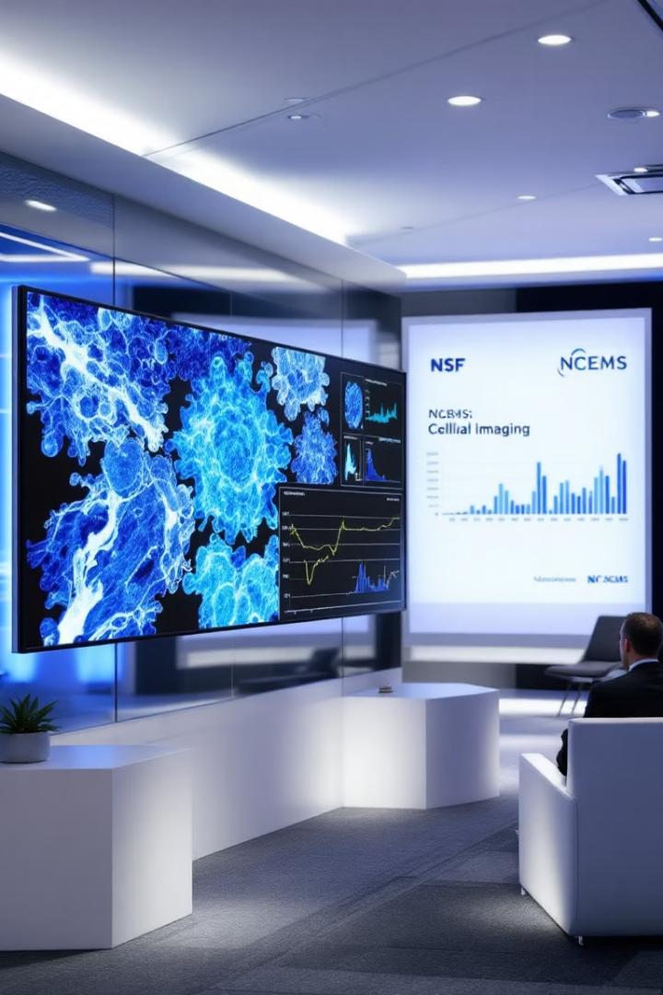
Revisiting Imaging Data: Extracting Quantitative Insights into Cellular Processes
NCEMS 2025 Focus Area Session
Tai-Yen Chen, University of Houston

Slide 2
The Goals and Outputs of this Focus Area Session
Goals:
- Brainstorm & identify community-scale synthesis opportunities that you are interested in
- Catalyze the formation of nascent teams to write 2-page proto-proposal by end of summit
Output: Groups of participants will
- Identify specific questions/methods that are primed for community-scale synthesis
- Explain the significance of the question/method and its potential impact
- Explore forming a nascent team to draft a proto-proposal (bonus
although not expected or required, as there are other sessions to take part in)
Constraints:
- Proto-proposal teams cannot have more than 4 PIs, and require a minimum of 2 PIs
- Participants can only be listed on one proto-proposal

Slide 3
Schedule for your Focus Area Session
Time | Description | Duration (min)
0:00 - 0:15 | Introduction: Brief introduction by the Session Lead(s) giving an overview of the format, goals, and the topic of the session. The overall topic area and direction of field will be described. | 15
0:15 - 0:45 | Breakout Brainstorm: Participants are randomly split into groups (limit of 5 max) to generate community-scale synthesis research questions related to the Focus Area topic. Each group member gets one vote to put towards a question that they would personally like to work on. The top two questions are submitted via Google Forms/Qualtrics. | 30
0:45 - 0:55 | Break: Participants get a 10-min break while lead(s) evaluate the questions submitted to remove duplicates. | 10
0:55 - 1:00 | Question Evaluation: Participants will look at all questions that emerge from the Breakout Brainstorm section and go to a question on which they are interested in working. Focus Area leads will help determine the areas to which those who want to work on different questions should go within the room. | 5
1:00 - 1:45 | Exploration: Participants discuss the questions and see if there is alignment; if there is not, move to another question of interest or start another group on a more focused approach to the question. Every 15 minutes, participants will be encouraged to look for another question of interest, but it is up to them to decide if they want to stick with the current option, explore other questions, or join the open discussion. | 45
1:45 - 2:00 | Convergence: Participants make a final decision on if there's a question around which they would like to form a nascent team. It is okay not to have a team or question(s) of interest, as there are other sessions. If participants want to lock-in this group, they may start the proto-proposal writing process. | 15

Slide 4
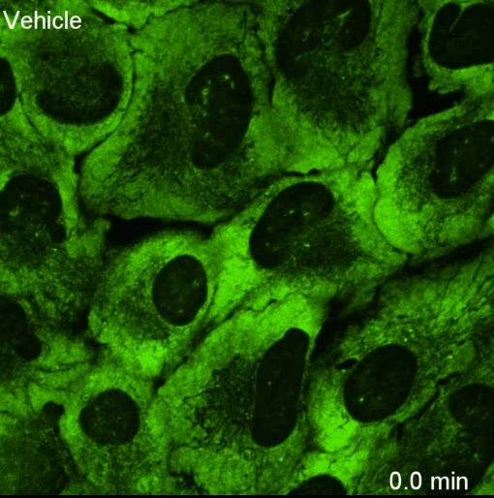
The State of the Field:
An Explosion of High-Resolution Data
stress granule
AI-driven imaging for quantifying
Condensates:
size, mobility, colocalization, …
Cells:
morphology, volume, neighboring cells, ….
Proteins:
abundance, locations
DOI: 10.1126/science.abf6548

Slide 5

The Critical Challenge: A Community Scale Problem
How is the assembly of dynamic cellular structures regulated?
How do their physical properties control biological function?
Experimental
Biology
The Opportunity:
A Synthesis of Disciplines
AI/Data Science
Biophysical
Modeling

Slide 6
Two Paths to a Synthesis Research
Method-Driven
Hypothesis-Driven
Structure: protein-RNA interaction site, geometry
Biophysical perspective: viscosity and mobility
Functional Genomics: altered functional pathways
e.g., A project on neurodegeneration:
FUS Mutation → Altered Condensate Physics → Neurotoxicity in ALS?
Experimentalist
AI Specialist
Biophysicist
High-fidelity data
Working Knowledge
Extracts hidden patterns
Quantifies complex data
Explains the “how“
Predicts system behaviors

Slide 7
Open Questions to Guide Brainstorming
Biophysical Perspective
What are the fundamental physical rules of cellular organization, and how can we build models to predict them?
Data Science / AI Perspective
Can we use AI to create a quantitative "cellular fingerprint" from multi-scale imaging data to predict cell state and fate?
Biological / Disease Perspective
Can we identify a "physical signature" of disease from imaging data that appears before traditional molecular markers?

Slide 8
Schedule for your Focus Area Session
Time | Description | Duration (min)
0:00 - 0:15 | Introduction: Brief introduction by the Session Lead(s) giving an overview of the format, goals, and the topic of the session. The overall topic area and direction of field will be described. | 15
0:15 - 0:45 | Breakout Brainstorm: Participants are randomly split into groups (limit of 5 max) to generate community-scale synthesis research questions related to the Focus Area topic. Each group member gets one vote to put towards a question that they would personally like to work on. The top two questions are submitted via Google Forms/Qualtrics. | 30
0:45 - 0:55 | Break: Participants get a 10-min break while lead(s) evaluate the questions submitted to remove duplicates. | 10
0:55 - 1:00 | Question Evaluation: Participants will look at all questions that emerge from the Breakout Brainstorm section and go to a question on which they are interested in working. Focus Area leads will help determine the areas to which those who want to work on different questions should go within the room. | 5
1:00 - 1:45 | Exploration: Participants discuss the questions and see if there is alignment; if there is not, move to another question of interest or start another group on a more focused approach to the question. Every 15 minutes, participants will be encouraged to look for another question of interest, but it is up to them to decide if they want to stick with the current option, explore other questions, or join the open discussion. | 45
1:45 - 2:00 | Convergence: Participants make a final decision on if there's a question around which they would like to form a nascent team. It is okay not to have a team or question(s) of interest, as there are other sessions. If participants want to lock-in this group, they may start the proto-proposal writing process. | 15

Slide 9
Schedule for your Focus Area Session
Time | Description | Duration (min)
0:00 - 0:15 | Introduction: Brief introduction by the Session Lead(s) giving an overview of the format, goals, and the topic of the session. The overall topic area and direction of field will be described. | 15
0:15 - 0:45 | Breakout Brainstorm: Participants are randomly split into groups (limit of 5 max) to generate community-scale synthesis research questions related to the Focus Area topic. Each group member gets one vote to put towards a question that they would personally like to work on. The top two questions are submitted via Google Forms/Qualtrics. | 30
0:45 - 0:55 | Break: Participants get a 10-min break while lead(s) evaluate the questions submitted to remove duplicates. | 10
0:55 - 1:00 | Question Evaluation: Participants will look at all questions that emerge from the Breakout Brainstorm section and go to a question on which they are interested in working. Focus Area leads will help determine the areas to which those who want to work on different questions should go within the room. | 5
1:00 - 1:45 | Exploration: Participants discuss the questions and see if there is alignment; if there is not, move to another question of interest or start another group on a more focused approach to the question. Every 15 minutes, participants will be encouraged to look for another question of interest, but it is up to them to decide if they want to stick with the current option, explore other questions, or join the open discussion. | 45
1:45 - 2:00 | Convergence: Participants make a final decision on if there's a question around which they would like to form a nascent team. It is okay not to have a team or question(s) of interest, as there are other sessions. If participants want to lock-in this group, they may start the proto-proposal writing process. | 15

Slide 10
Schedule for your Focus Area Session
Time | Description | Duration (min)
0:00 - 0:15 | Introduction: Brief introduction by the Session Lead(s) giving an overview of the format, goals, and the topic of the session. The overall topic area and direction of field will be described. | 15
0:15 - 0:45 | Breakout Brainstorm: Participants are randomly split into groups (limit of 5 max) to generate community-scale synthesis research questions related to the Focus Area topic. Each group member gets one vote to put towards a question that they would personally like to work on. The top two questions are submitted via Google Forms/Qualtrics. | 30
0:45 - 0:55 | Break: Participants get a 10-min break while lead(s) evaluate the questions submitted to remove duplicates. | 10
0:55 - 1:00 | Question Evaluation: Participants will look at all questions that emerge from the Breakout Brainstorm section and go to a question on which they are interested in working. Focus Area leads will help determine the areas to which those who want to work on different questions should go within the room. | 5
1:00 - 1:45 | Exploration: Participants discuss the questions and see if there is alignment; if there is not, move to another question of interest or start another group on a more focused approach to the question. Every 15 minutes, participants will be encouraged to look for another question of interest, but it is up to them to decide if they want to stick with the current option, explore other questions, or join the open discussion. | 45
1:45 - 2:00 | Convergence: Participants make a final decision on if there's a question around which they would like to form a nascent team. It is okay not to have a team or question(s) of interest, as there are other sessions. If participants want to lock-in this group, they may start the proto-proposal writing process. | 15

Slide 11
Schedule for your Focus Area Session
Time | Description | Duration (min)
0:00 - 0:15 | Introduction: Brief introduction by the Session Lead(s) giving an overview of the format, goals, and the topic of the session. The overall topic area and direction of field will be described. | 15
0:15 - 0:45 | Breakout Brainstorm: Participants are randomly split into groups (limit of 5 max) to generate community-scale synthesis research questions related to the Focus Area topic. Each group member gets one vote to put towards a question that they would personally like to work on. The top two questions are submitted via Google Forms/Qualtrics. | 30
0:45 - 0:55 | Break: Participants get a 10-min break while lead(s) evaluate the questions submitted to remove duplicates. | 10
0:55 - 1:00 | Question Evaluation: Participants will look at all questions that emerge from the Breakout Brainstorm section and go to a question on which they are interested in working. Focus Area leads will help determine the areas to which those who want to work on different questions should go within the room. | 5
1:00 - 1:45 | Exploration: Participants discuss the questions and see if there is alignment; if there is not, move to another question of interest or start another group on a more focused approach to the question. Every 15 minutes, participants will be encouraged to look for another question of interest, but it is up to them to decide if they want to stick with the current option, explore other questions, or join the open discussion. | 45
1:45 - 2:00 | Convergence: Participants make a final decision on if there's a question around which they would like to form a nascent team. It is okay not to have a team or question(s) of interest, as there are other sessions. If participants want to lock-in this group, they may start the proto-proposal writing process. | 15

Slide 12
Schedule for your Focus Area Session
Time | Description | Duration (min)
0:00 - 0:15 | Introduction: Brief introduction by the Session Lead(s) giving an overview of the format, goals, and the topic of the session. The overall topic area and direction of field will be described. | 15
0:15 - 0:45 | Breakout Brainstorm: Participants are randomly split into groups (limit of 5 max) to generate community-scale synthesis research questions related to the Focus Area topic. Each group member gets one vote to put towards a question that they would personally like to work on. The top two questions are submitted via Google Forms/Qualtrics. | 30
0:45 - 0:55 | Break: Participants get a 10-min break while lead(s) evaluate the questions submitted to remove duplicates. | 10
0:55 - 1:00 | Question Evaluation: Participants will look at all questions that emerge from the Breakout Brainstorm section and go to a question on which they are interested in working. Focus Area leads will help determine the areas to which those who want to work on different questions should go within the room. | 5
1:00 - 1:45 | Exploration: Participants discuss the questions and see if there is alignment; if there is not, move to another question of interest or start another group on a more focused approach to the question. Every 15 minutes, participants will be encouraged to look for another question of interest, but it is up to them to decide if they want to stick with the current option, explore other questions, or join the open discussion. | 45
1:45 - 2:00 | Convergence: Participants make a final decision on if there's a question around which they would like to form a nascent team. It is okay not to have a team or question(s) of interest, as there are other sessions. If participants want to lock-in this group, they may start the proto-proposal writing process. | 15

