Slide 1
Synergizing AI and MD Simulation for Enhanced Biomolecular Functional Predictions -- Xingcheng Lin (NCSU Physics) & Tianlong Chen (UNC Chapel-Hill Computer Science)

Slide 2
The Goals and Outputs of this Focus Area Session
Goals:
- Brainstorm & identify community-scale synthesis opportunities that you are interested in
- Catalyze the formation of nascent teams to write 2-page proto-proposal by end of summit
Output: Groups of participants will
- Identify specific questions/methods that are primed for community-scale synthesis
- Explain the significance of the question/method and its potential impact
- Explore forming a nascent team to draft a proto-proposal (bonus
although not expected or required, as there are other sessions to take part in)
Constraints:
- Proto-proposal teams cannot have more than 4 PIs, and require a minimum of 2 PIs
- Participants can only be listed on one proto-proposal

Slide 3
Schedule for your Focus Area Session
Time | Description | Duration (min)
0:00 - 0:15 | Introduction: Brief introduction by the Session Lead(s) giving an overview of the format, goals, and the topic of the session. The overall topic area and direction of field will be described. | 15
0:15 - 0:45 | Breakout Brainstorm: Participants are randomly split into groups (limit of 5 max) to generate community-scale synthesis research questions related to the Focus Area topic. Each group member gets one vote to put towards a question that they would personally like to work on. The top two questions are submitted via Google Forms/Qualtrics. | 30
0:45 - 0:55 | Break: Participants get a 10-min break while lead(s) evaluate the questions submitted to remove duplicates. | 10
0:55 - 1:00 | Question Evaluation: Participants will look at all questions that emerge from the Breakout Brainstorm section and go to a question on which they are interested in working. Focus Area leads will help determine the areas to which those who want to work on different questions should go within the room. | 5
1:00 - 1:45 | Exploration: Participants discuss the questions and see if there is alignment; if there is not, move to another question of interest or start another group on a more focused approach to the question. Every 15 minutes, participants will be encouraged to look for another question of interest, but it is up to them to decide if they want to stick with the current option, explore other questions, or join the open discussion. | 45
1:45 - 2:00 | Convergence: Participants make a final decision on if there's a question around which they would like to form a nascent team. It is okay not to have a team or question(s) of interest, as there are other sessions. If participants want to lock-in this group, they may start the proto-proposal writing process. | 15

Slide 4
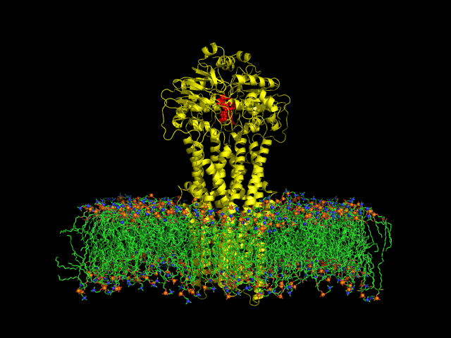
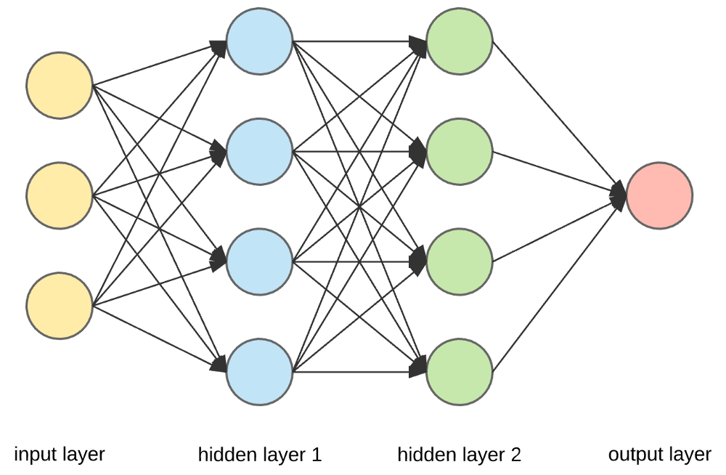
Synergizing AI and MD Simulation for Enhanced Biomolecular Functional Predictions (Synthesis Question)
Deep connections between AI and MD simulations
-- Work by Tiwary, Noé, Clementi, Rotskoff, White, Ferguson, etc.
http://guillefix.me/cosmos/static/Molecular%2520dynamics.html

Slide 5

Enhance Biomolecular Function Predictions by Leveraging Molecular Dynamics Simulations
Opportunities
Motivation
Recent development in biomolecular simulation force fields (all-atom and coarse-grained)
AI-based MD generations are efficient (AlphaFlow, ESMflow, MDGen, etc.)
Protein functions are governed by sequence, structure, and thermodynamic rules.
Integrating MD simulations in AI frameworks to predict biomolecular functions and facilitate in silico design of functional biomolecules
Trends in the field
Large protein language models (ESM, ProtTrans, PorteinBERT, etc.)
Structural encoding benefits protein function predictions (Saprot, LM-GVP, ESM-GearNet, etc.)
Protein predictions benefit from simulated ensemble (SeqDance, DynamicGT, etc)
Can we benefit protein (biomolecular) functional prediction with temporal information from MD simulations?
What open questions can we address collaboratively as a community?

Slide 6
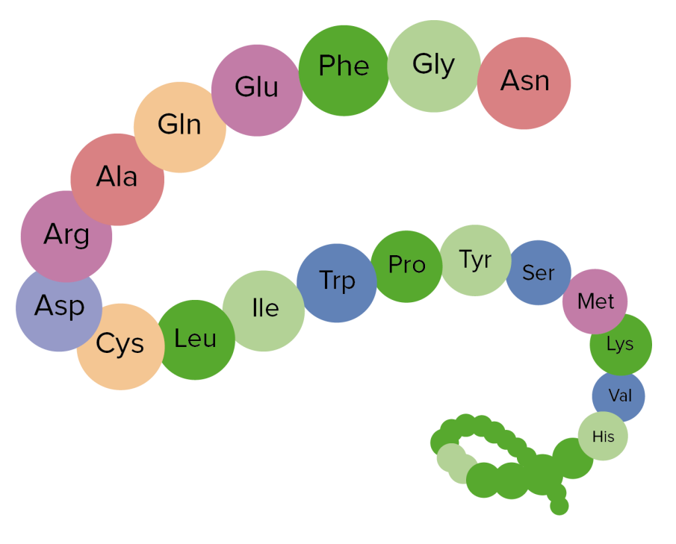
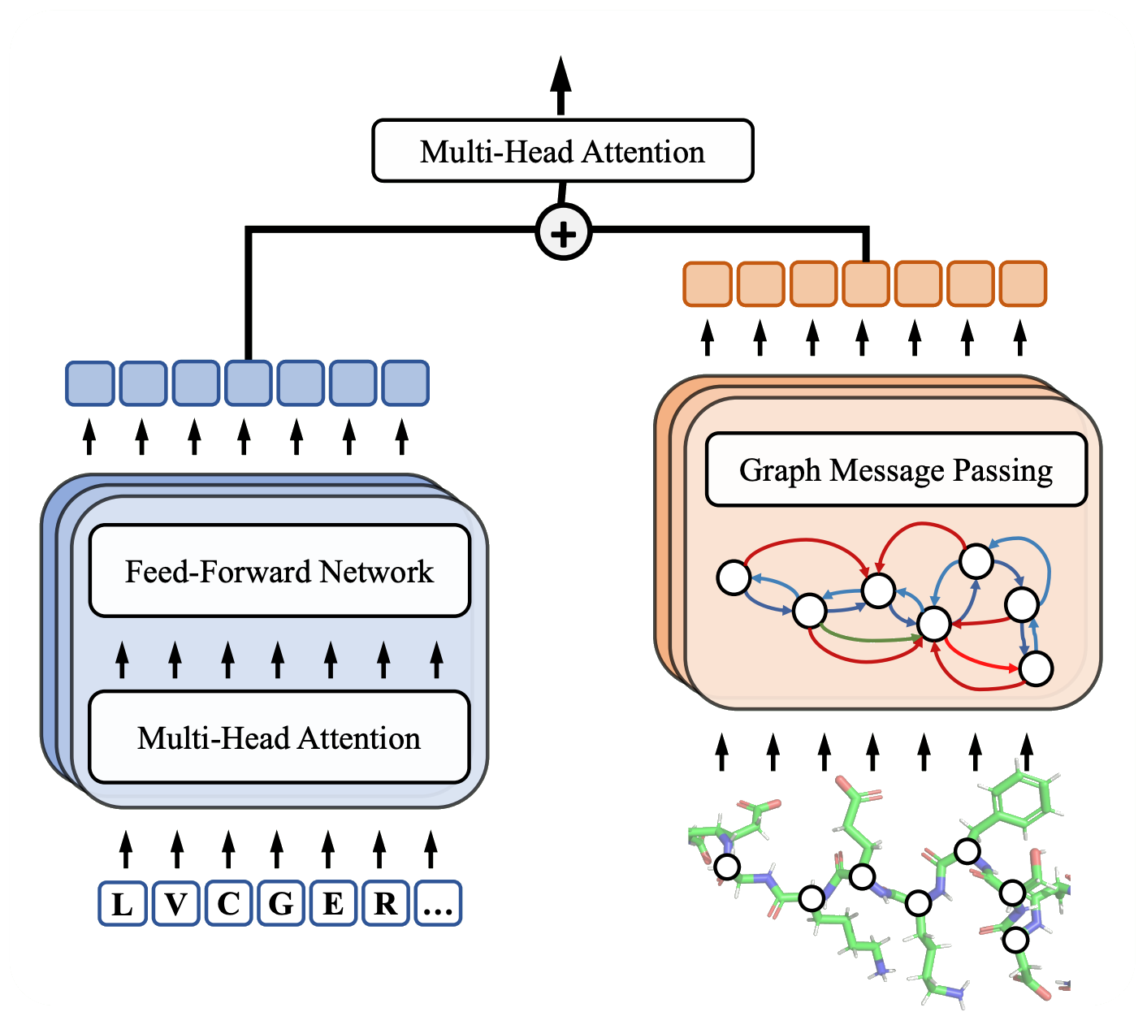
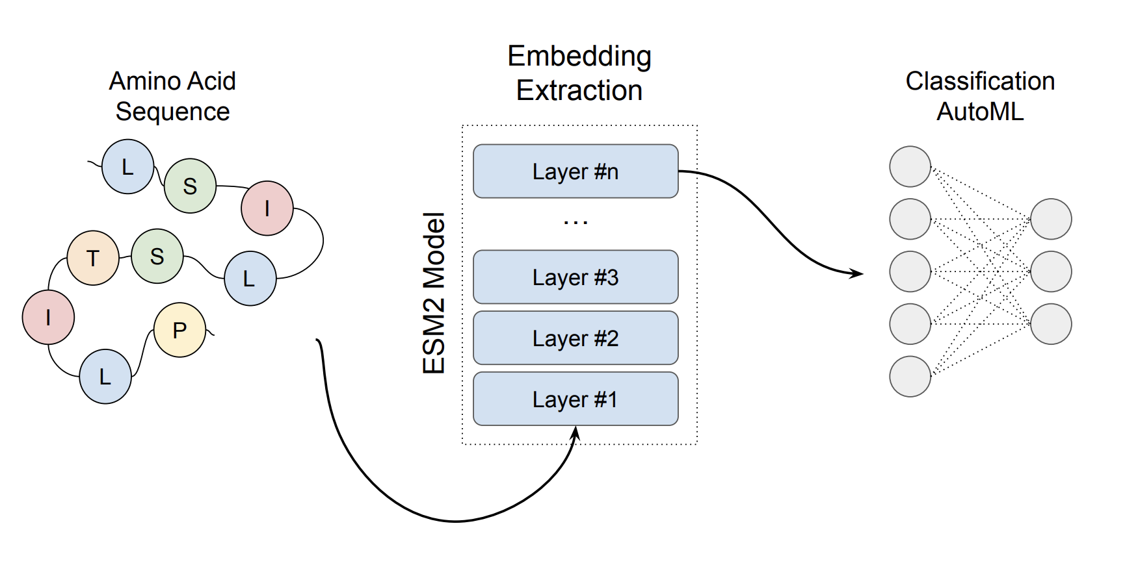
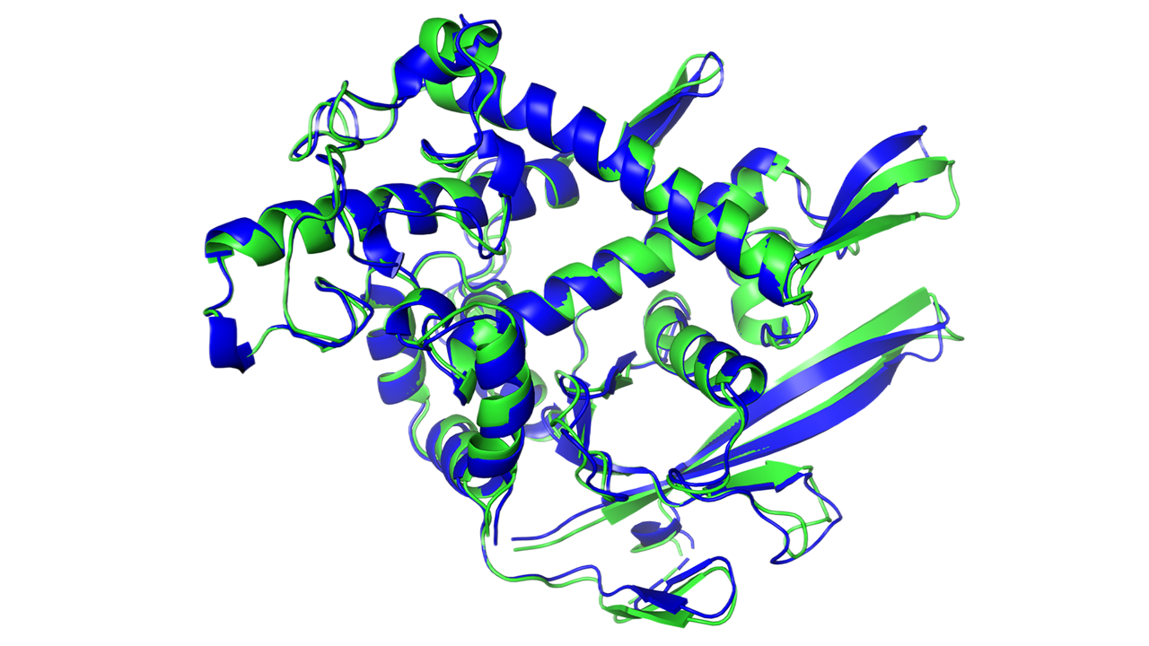
Amino Acid Sequence
Protein Sequence Model
Downstream Task Layer
Embedding Fusion
Protein Structure Model
Protein 3D Structure

Slide 7
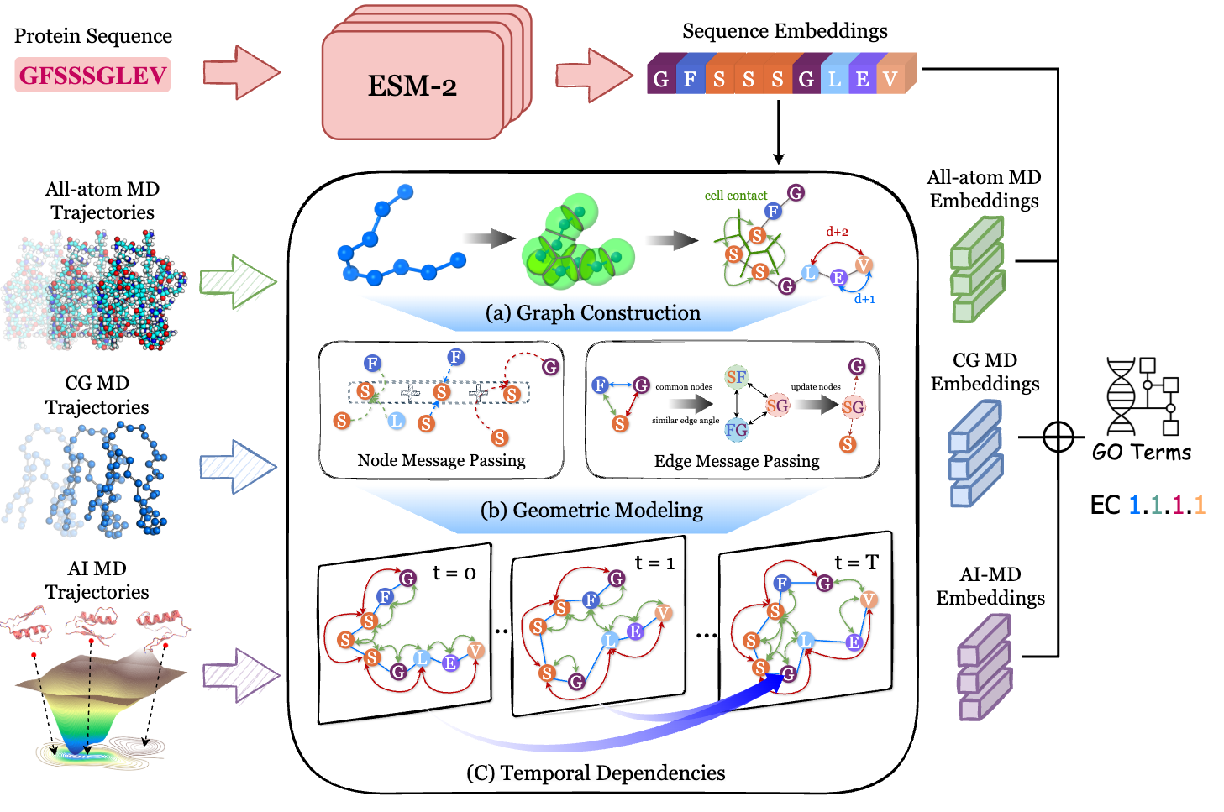
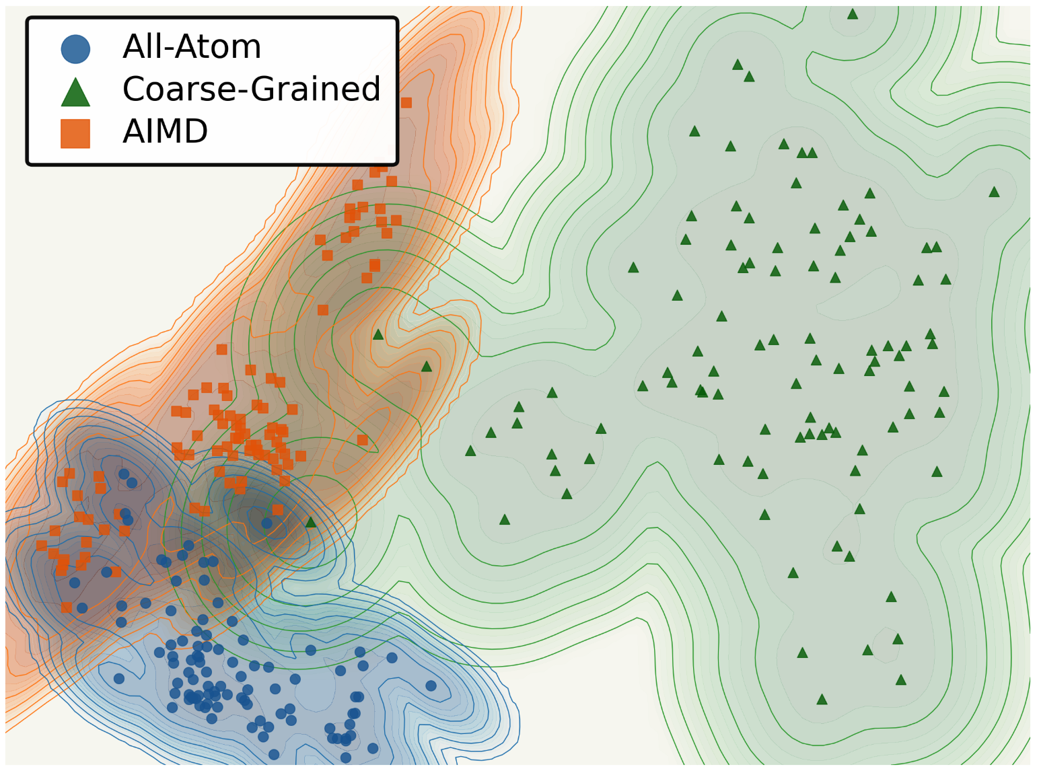
Example: MD4PLM – Functional Prediction by Protein Dynamics
Motivation:
1. Protein function is governed by sequence, structure, and critically, its thermodynamic dynamics
2. Different types of MD simulation provide complementary insights into protein dynamics

Slide 8
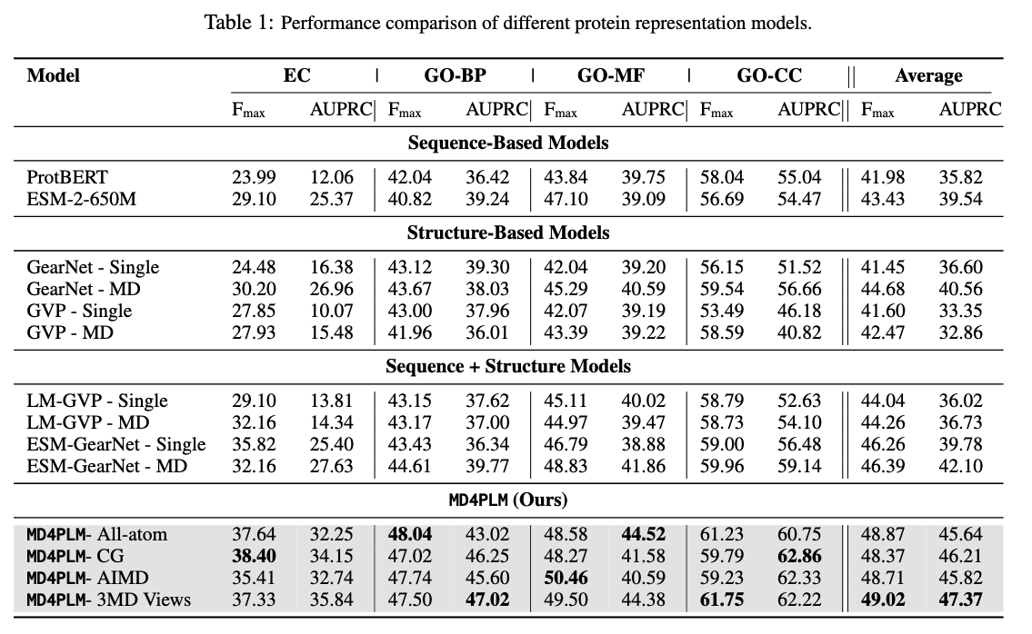

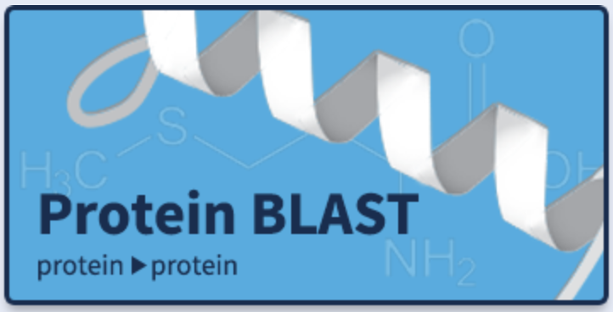
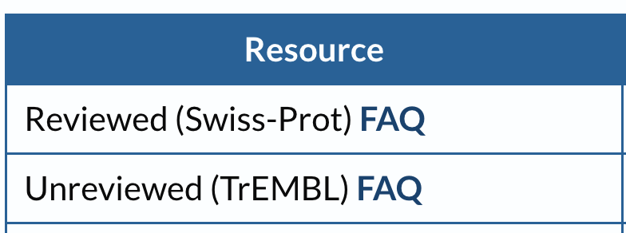
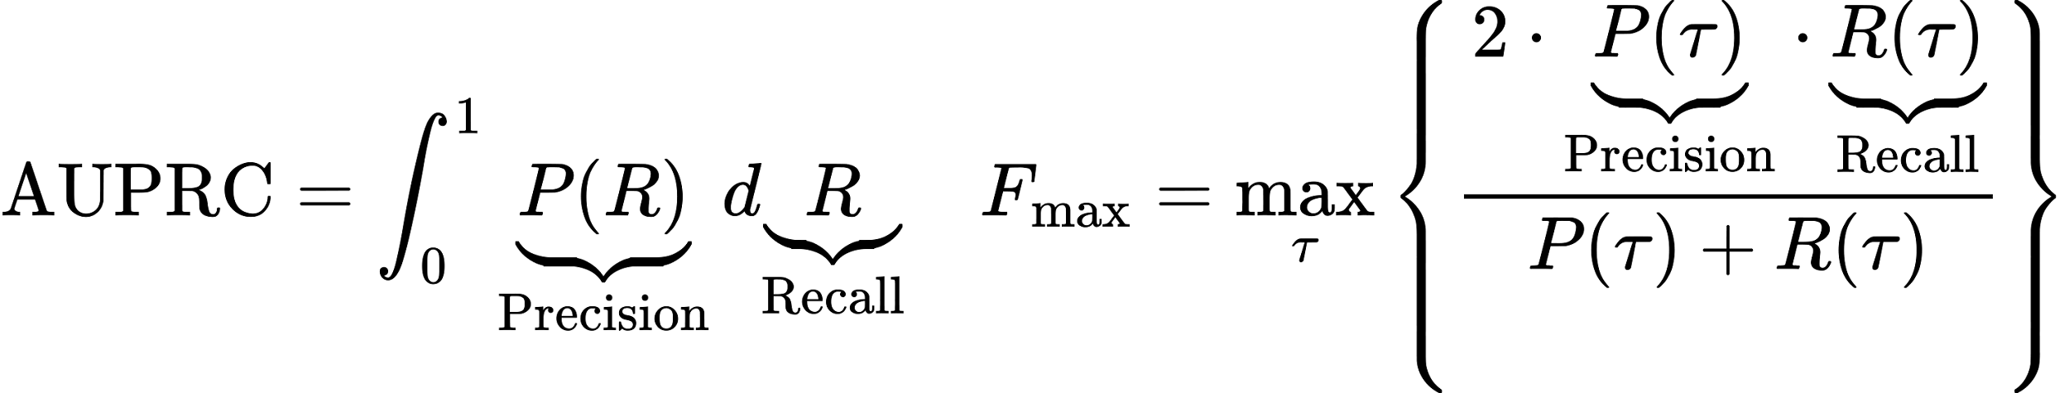
Example: MD4PLM – Functional Prediction by Protein Dynamics
Superior Performance in Function Prediction
Function Annotation
PDB w/
SIFTS labels
PDB wo/ SIFTS labels
We are expanding the database to 30k simulated chains, 4k GO terms, and 300 EC numbers through EggNOG pipeline
Function Annotation Space
Gene Ontology (GO) Terms:
1. Molecular Function – 98 terms
2. Biological Process – 372 terms
3. Cellular Component – 76 terms
Enzyme Commission (EC) Numbers: 131 numbers

Slide 9
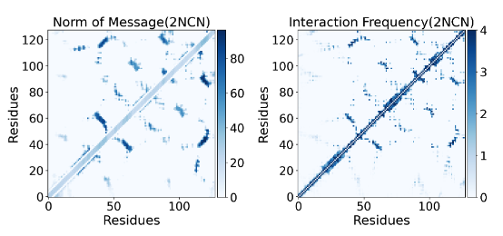
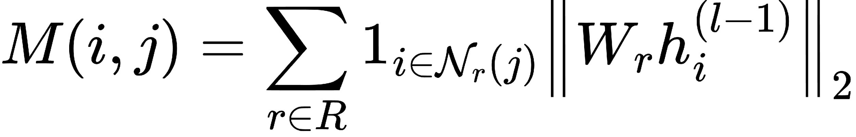
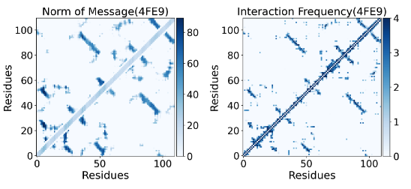
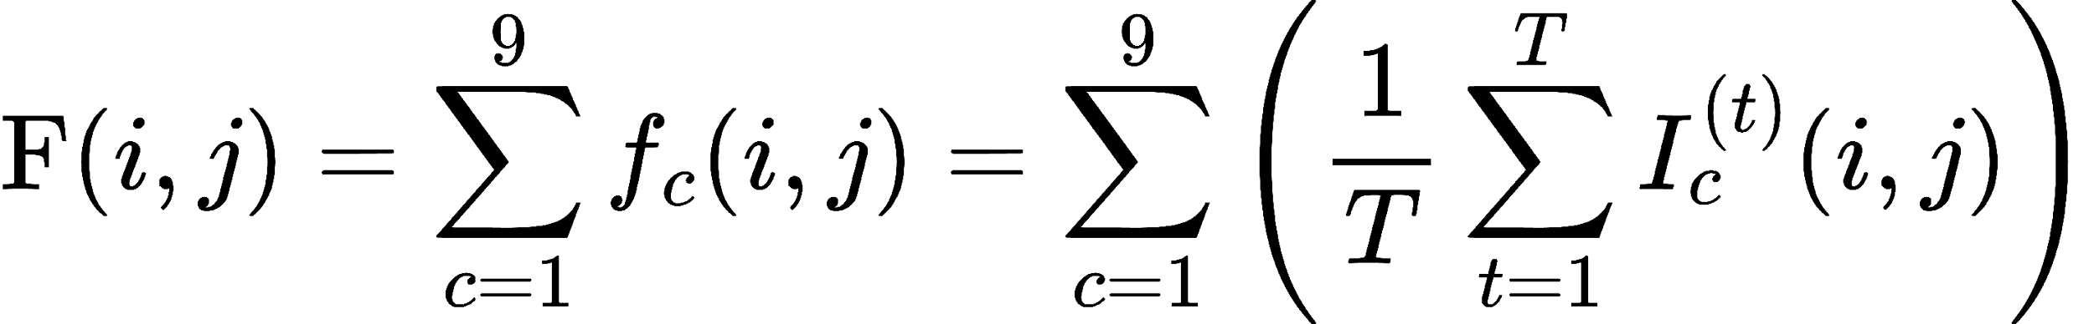
Example: MD4PLM – Functional Prediction by Protein Dynamics
Message Passing Captures Protein Dynamics
Predicted Interaction Strength
Interaction Frequency from MD Trajectories
Notes:
Figure
The figure compares the model's predicted interaction strength (Norm of GNNs Message) with the ground-truth contact frequency （9 types of fundamental molecular interactions） derived from MD simulations.
They are figures for 2 proteins 1BGQ-A0 and 1B4U-B0 (from MDCATH dataset)
We extract 9 types of realistic interactions from MD simulation trajectories, using https://github.com/getcontacts/getcontacts:
backbone-to-backbone hydrogen bonds
side-chain-to-backbone hydrogen bonds
side-chain-to-side chain hydrogen bonds
salt bridges
Pi-cation
Pi-stacking
T-stacking
hydrophobic interactions
van der Waals interactions
M(i, j) is the predicted message strength between 2 residues
i, j is the residue index
R is the edge relation set (sequential + spatial edges)
W_r is the weight for relation r
h_k is the hidden states of sample k in the neighbors of I
F(i,j) is the interaction frequency between i, j
C is the index of interaction type, we have 9 types
T is the total number frames, t is the time step
I is the indicator for interaction c, whether it is happen

Slide 10
Some Open Questions:
Methodology development:
What AI frameworks can incorporate structural ensembles with temporal resolution?
What is the optimal duration for molecular dynamics (MD) simulations?
What are the ideal sampling intervals?
How can we integrate simulations from different coarse-grained levels in predicting protein functions?
Can we assess our prediction with a confidence score (like AF) and degree of generalizability?
Mechanistic insights?
Training data:
MD simulations or other experimental structural ensembles?
Force field selections? AI-MD generation
Validation data (ground-truth dataset):
What functional properties are most reliable for predictions (GO, EC, thermostability ligand-binding sites, evolutionary covariance)
How can we accurately annotate protein functions (order/disorder regions)?
Application:
How can we extend functional predictions to protein design?

Slide 11
Schedule for your Focus Area Session
Time | Description | Duration (min)
0:00 - 0:15 | Introduction: Brief introduction by the Session Lead(s) giving an overview of the format, goals, and the topic of the session. The overall topic area and direction of field will be described. | 15
0:15 - 0:45 | Breakout Brainstorm: Participants are randomly split into groups (limit of 5 max) to generate community-scale synthesis research questions related to the Focus Area topic. Each group member gets one vote to put towards a question that they would personally like to work on. The top two questions are submitted via Google Forms/Qualtrics. | 30
0:45 - 0:55 | Break: Participants get a 10-min break while lead(s) evaluate the questions submitted to remove duplicates. | 10
0:55 - 1:00 | Question Evaluation: Participants will look at all questions that emerge from the Breakout Brainstorm section and go to a question on which they are interested in working. Focus Area leads will help determine the areas to which those who want to work on different questions should go within the room. | 5
1:00 - 1:45 | Exploration: Participants discuss the questions and see if there is alignment; if there is not, move to another question of interest or start another group on a more focused approach to the question. Every 15 minutes, participants will be encouraged to look for another question of interest, but it is up to them to decide if they want to stick with the current option, explore other questions, or join the open discussion. | 45
1:45 - 2:00 | Convergence: Participants make a final decision on if there's a question around which they would like to form a nascent team. It is okay not to have a team or question(s) of interest, as there are other sessions. If participants want to lock-in this group, they may start the proto-proposal writing process. | 15

Slide 12
Schedule for your Focus Area Session
Time | Description | Duration (min)
0:00 - 0:15 | Introduction: Brief introduction by the Session Lead(s) giving an overview of the format, goals, and the topic of the session. The overall topic area and direction of field will be described. | 15
0:15 - 0:45 | Breakout Brainstorm: Participants are randomly split into groups (limit of 5 max) to generate community-scale synthesis research questions related to the Focus Area topic. Each group member gets one vote to put towards a question that they would personally like to work on. The top two questions are submitted via Google Forms/Qualtrics. | 30
0:45 - 0:55 | Break: Participants get a 10-min break while lead(s) evaluate the questions submitted to remove duplicates. | 10
0:55 - 1:00 | Question Evaluation: Participants will look at all questions that emerge from the Breakout Brainstorm section and go to a question on which they are interested in working. Focus Area leads will help determine the areas to which those who want to work on different questions should go within the room. | 5
1:00 - 1:45 | Exploration: Participants discuss the questions and see if there is alignment; if there is not, move to another question of interest or start another group on a more focused approach to the question. Every 15 minutes, participants will be encouraged to look for another question of interest, but it is up to them to decide if they want to stick with the current option, explore other questions, or join the open discussion. | 45
1:45 - 2:00 | Convergence: Participants make a final decision on if there's a question around which they would like to form a nascent team. It is okay not to have a team or question(s) of interest, as there are other sessions. If participants want to lock-in this group, they may start the proto-proposal writing process. | 15

Slide 13
Schedule for your Focus Area Session
Time | Description | Duration (min)
0:00 - 0:15 | Introduction: Brief introduction by the Session Lead(s) giving an overview of the format, goals, and the topic of the session. The overall topic area and direction of field will be described. | 15
0:15 - 0:45 | Breakout Brainstorm: Participants are randomly split into groups (limit of 5 max) to generate community-scale synthesis research questions related to the Focus Area topic. Each group member gets one vote to put towards a question that they would personally like to work on. The top two questions are submitted via Google Forms/Qualtrics. | 30
0:45 - 0:55 | Break: Participants get a 10-min break while lead(s) evaluate the questions submitted to remove duplicates. | 10
0:55 - 1:00 | Question Evaluation: Participants will look at all questions that emerge from the Breakout Brainstorm section and go to a question on which they are interested in working. Focus Area leads will help determine the areas to which those who want to work on different questions should go within the room. | 5
1:00 - 1:45 | Exploration: Participants discuss the questions and see if there is alignment; if there is not, move to another question of interest or start another group on a more focused approach to the question. Every 15 minutes, participants will be encouraged to look for another question of interest, but it is up to them to decide if they want to stick with the current option, explore other questions, or join the open discussion. | 45
1:45 - 2:00 | Convergence: Participants make a final decision on if there's a question around which they would like to form a nascent team. It is okay not to have a team or question(s) of interest, as there are other sessions. If participants want to lock-in this group, they may start the proto-proposal writing process. | 15

Slide 14
Schedule for your Focus Area Session
Time | Description | Duration (min)
0:00 - 0:15 | Introduction: Brief introduction by the Session Lead(s) giving an overview of the format, goals, and the topic of the session. The overall topic area and direction of field will be described. | 15
0:15 - 0:45 | Breakout Brainstorm: Participants are randomly split into groups (limit of 5 max) to generate community-scale synthesis research questions related to the Focus Area topic. Each group member gets one vote to put towards a question that they would personally like to work on. The top two questions are submitted via Google Forms/Qualtrics. | 30
0:45 - 0:55 | Break: Participants get a 10-min break while lead(s) evaluate the questions submitted to remove duplicates. | 10
0:55 - 1:00 | Question Evaluation: Participants will look at all questions that emerge from the Breakout Brainstorm section and go to a question on which they are interested in working. Focus Area leads will help determine the areas to which those who want to work on different questions should go within the room. | 5
1:00 - 1:45 | Exploration: Participants discuss the questions and see if there is alignment; if there is not, move to another question of interest or start another group on a more focused approach to the question. Every 15 minutes, participants will be encouraged to look for another question of interest, but it is up to them to decide if they want to stick with the current option, explore other questions, or join the open discussion. | 45
1:45 - 2:00 | Convergence: Participants make a final decision on if there's a question around which they would like to form a nascent team. It is okay not to have a team or question(s) of interest, as there are other sessions. If participants want to lock-in this group, they may start the proto-proposal writing process. | 15

Slide 15
Prompt Questions
Do you want to refine this synthesis question? If so, restate the question below
Describe the significance of the anticipated answer/outcome of this synthesis question/method
What are some of the key milestones you need to achieve to answer this question?

Slide 16
Schedule for your Focus Area Session
Time | Description | Duration (min)
0:00 - 0:15 | Introduction: Brief introduction by the Session Lead(s) giving an overview of the format, goals, and the topic of the session. The overall topic area and direction of field will be described. | 15
0:15 - 0:45 | Breakout Brainstorm: Participants are randomly split into groups (limit of 5 max) to generate community-scale synthesis research questions related to the Focus Area topic. Each group member gets one vote to put towards a question that they would personally like to work on. The top two questions are submitted via Google Forms/Qualtrics. | 30
0:45 - 0:55 | Break: Participants get a 10-min break while lead(s) evaluate the questions submitted to remove duplicates. | 10
0:55 - 1:00 | Question Evaluation: Participants will look at all questions that emerge from the Breakout Brainstorm section and go to a question on which they are interested in working. Focus Area leads will help determine the areas to which those who want to work on different questions should go within the room. | 5
1:00 - 1:45 | Exploration: Participants discuss the questions and see if there is alignment; if there is not, move to another question of interest or start another group on a more focused approach to the question. Every 15 minutes, participants will be encouraged to look for another question of interest, but it is up to them to decide if they want to stick with the current option, explore other questions, or join the open discussion. | 45
1:45 - 2:00 | Convergence: Participants make a final decision on if there's a question around which they would like to form a nascent team. It is okay not to have a team or question(s) of interest, as there are other sessions. If participants want to lock-in this group, they may start the proto-proposal writing process. | 15

Slide 17
If you have refined questions, please email them to ncems@psu.edu

